Slide 1
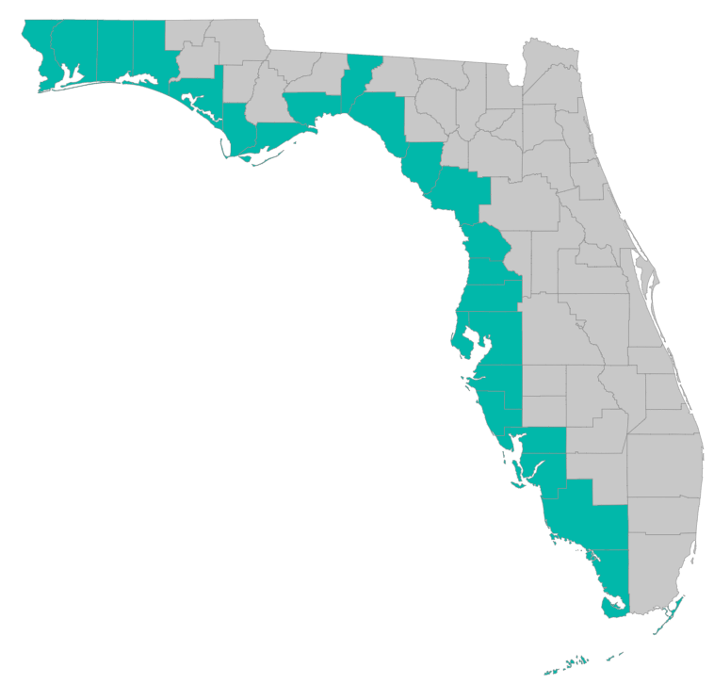
SEP Project Implementation – updates and Q&A
November 20, 2019 – GoToMeeting
Please join my meeting from your computer, tablet or smartphone. https://global.gotomeeting.com/join/785710869 You can also dial in using your phone. United States: +1 (312) 757-3119 Access Code: 785-710-869

Slide 2
SEP Project Implementation info session agenda
Grant application status
Checklists, templates, guidance
https://www.gulfconsortium.org/grant-resources
What applications should proceed?
County procurements and 2 CFR 200 compliance discussion
Post-award tracking of time for County personnel
SEP amendment #2
Q&A

Slide 3
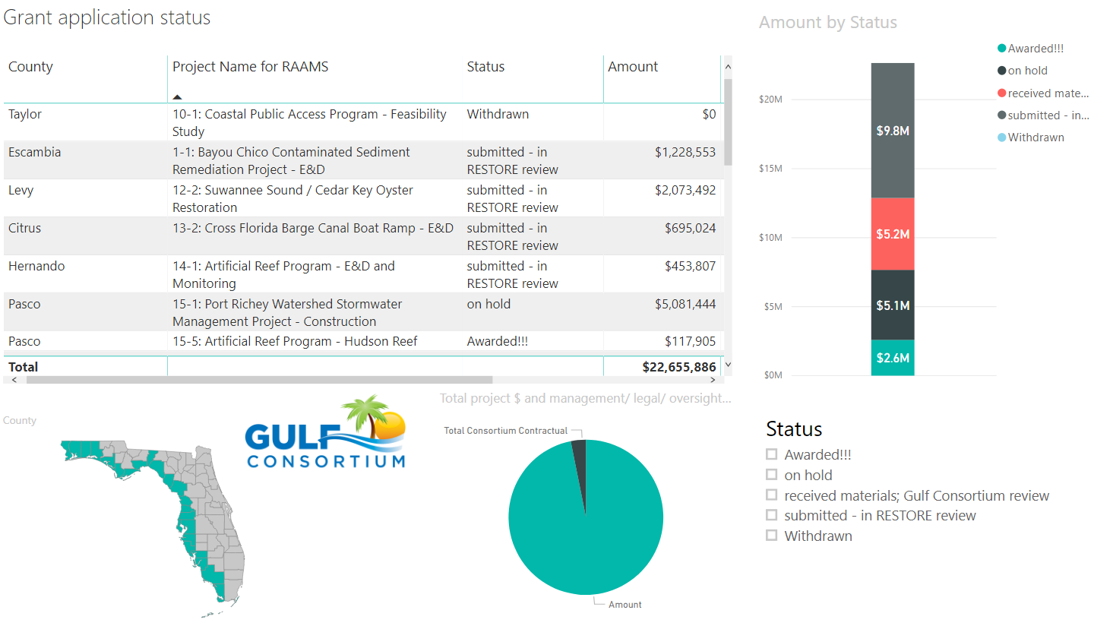
Application Status
Where’s my application, when will an award be made?
http://datavisual.balmoralgroup.us/GulfConsortiumProjects

Slide 4
Application Status
Where’s my application, when will an award be made?
http://datavisual.balmoralgroup.us/GulfConsortiumProjects
Status: Awarded!!!
4 awards currently active (covering 7 SEP Projects; about $2.6M), with 12 additional grants submitted for approval. The current awards:
Lake Seminole dredging for water quality improvement – Pinellas County
Wastewater Improvement/Septic to Sewer conversions for four counties – Santa Rosa, Okaloosa, Citrus, and Charlotte Counties
Bayside Marina Feasibility Study – Wakulla County
Artificial Reef expansion (offshore Hudson Reef) – Pasco County

Slide 5
Application Timeline
How long does it take from Gulf Consortium application to award?
The short answer…
About 5 months:
From Gulf Consortium Board approval to award with sub-recipient agreement
5 to 6 months

Slide 6
Reviews for completeness; BAS external review; makes request for edits
Final reviews and award preparation; Award made
Grant application and award timeline estimates
RESTORE Council
10 to 15 weeks
5 to 8 weeks
Reviews sub-recipient applications; revisions made; coordination with County
Get Board approval; submit to RESTORE Council
Makes edits and BAS responses; resubmits application to RESTORE Council
Award review and acceptance; sub-recipient agreement delivery
Work begins, reporting required, payment requests allowed
General Manager
1 to 3 weeks
2 to 4 weeks
1 to 3 weeks
1 to 3 weeks
Prepares application(s); submits to Gulf Consortium management
Provide additional information as needed
Provide additional information as needed
Subrecipient agreement review and approval; possible BOCC action needed
Counties
1 to 4 weeks
From the time a county submits a grant application: about 20 weeks to award (should improve)
You are here
1 to 4 weeks

Slide 7
Application Preparation – guidance
What is needed to submit a subaward application?
See guidance documents and templates at
https://www.gulfconsortium.org/grant-resources
Project Abstract
Project Narrative (BAS)
Budget Narrative
Budget Table (SF 424 object class categories)
Milestone information
Metrics information (BAS)
Environmental Compliance Checklist
Project Map
GIS shapefiles
Data Management Plan (BAS)
Observational Data Plan (BAS)
Cash Drawdown Projection and Leveraged Funding form

Slide 8
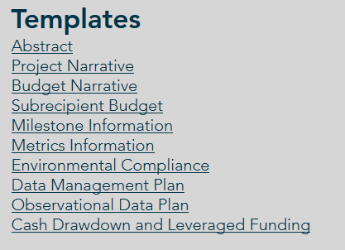
Application Preparation – guidance
What is needed to submit a subaward application?
https://www.gulfconsortium.org/grant-resources
Please use templates: more complete applications = less management cost
Save each of the blank templates; then save as project-specific name and fill them in

Slide 9
Application Preparation – upcoming applications
Next suggested date to submit applications by: 12/20/2019
Don’t need to wait until then – submit whenever you’re ready
What portions of projects can proceed? Anything with a 2019 or 2020 start date in the SEP… see http://datavisual.balmoralgroup.us/GulfConsortiumProjects and ask us for help or suggestions

Slide 10
RESTORE Council grants management system transitions
RAAMS (RESTORE Council’s Grant Mgmt System) goes dark
Jan 31, 2020
New systems go live (GrantSolutions and PIPER)
Mar 16, 2020

Slide 11
RESTORE Council grants management system transitions
RAAMS (RESTORE Council’s Grant Mgmt System) goes dark
why’s that matter?
Gulf Consortium applications approved at the January Board meeting will have to wait until Mar 16 for Gulf Consortium to submit to RESTORE Council
Jan 31 to Mar 16, 2020 – no RESTORE Council Grants Management System

Slide 12
Application Preparation – upcoming applications
IMPORTANT for reducing overhead:
Don’t separate projects into smaller pieces than necessary… every grant/project needs an application and twice-annual performance and financial reports
Look at the most complete tangible deliverable you can complete with the information you have and submit for that milestone(s)

Slide 13
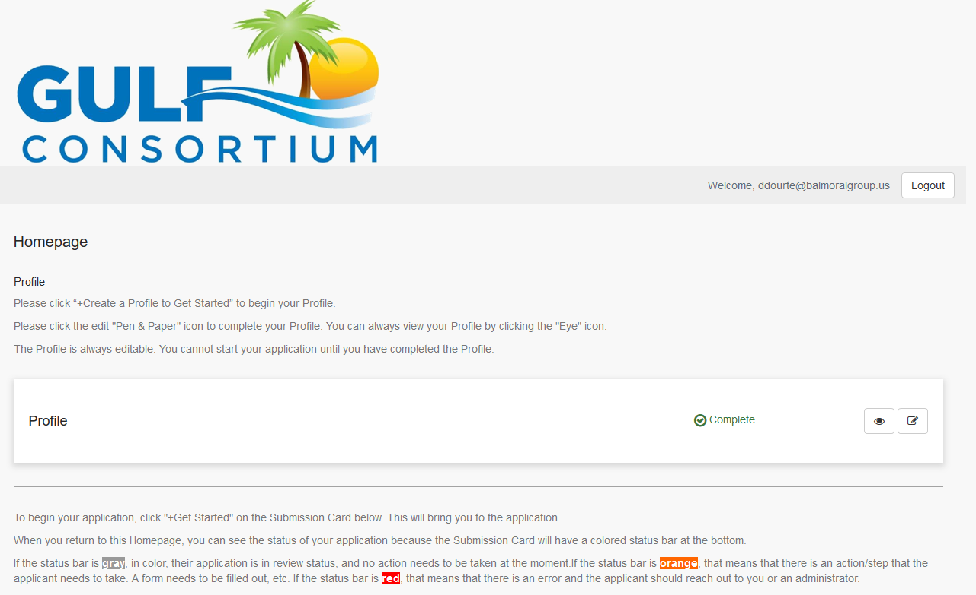
Application Preparation – upcoming applications
How to submit a subaward application? NEW grants mgmt. system
https://webportalapp.com/sp/gulfconsortium_sep_projects

Slide 14
Application Preparation – upcoming applications
Start with templates
https://www.gulfconsortium.org/grant-resources
See example materials
https://drive.google.com/drive/folders/1aELD3bw5M0TqJ2QoghS8EfyguhyqxECb

Slide 15
Application Preparation – upcoming applications
How to submit a subaward application? NEW grants mgmt. system
Make a profile
Add an application
Fill out and submit an application
Use templates locally or on your servers to make complete application attachments before submittal (budget, budget narrative, etc.)
https://webportalapp.com/sp/gulfconsortium_sep_projects

Slide 16
Procurements
Compliance with: 2 CFR § 200.319 – Competition
2 CFR § 200.320 - Methods of procurement to be followed
If you already hired someone to do the work:
Explain the procurement (in Budget Narrative) and past involvement of selected firm (if applicable)
Send procurement backup to Gulf Consortium (ddourte@balmoralgroup.us):
RFP
Winning response
Resulting contract
If you will do a new procurement:
Explain the procurement (in Budget Narrative)
Describe compliance with county policies and federal rules

Slide 17
Procurements
Compliance with: 2 CFR § 200.319 – Competition
2 CFR § 200.320 - Methods of procurement to be followed
Common question…
Consultant was hired to do preliminary design, can they compete for final design?
Answer: it will based on Gulf Consortium policy, consultation with General Counsel, and judgement of RESTORE Council

Slide 18
Procurements
Compliance with: 2 CFR § 200.319 – Competition
2 CFR § 200.320 - Methods of procurement to be followed
Process:
The particular type of past involvement and type of procurement both matter – needs described in budget narrative
RESTORE Council: “County should certify to the Consortium that the work done in the past will not result in an unfair competitive advantage to the firm that had worked on the project previously and that 2 CFR 200.319 will be adhered to for each future contract”
County’s general counsel will need to certify that all requirements of § 200.319 were complied with in the procurement process
Case-by-case review by Gulf Consortium legal counsel

Slide 19
Award acceptance, agreements, project kickoff
After RESTORE Council makes an award:
Gulf Consortium reviews and accepts award
Management and Legal review of award conditions
Signed by chairman
Submitted in RAAMS
Award from Consortium to County: to be accepted by County https://webportalapp.com/sp/gulfconsortium_sep_projects
Sub-recipient agreement established (Gulf Consortium and County) – standard or special conditions
Gulf Consortium and County meeting to review scope, milestones, budget

Slide 20
Post-award reporting
Twice each year (financial and performance reports)
See example forms at https://www.gulfconsortium.org/grant-resources bottom of page “Example Semi-Annual Report and Payment Request”
Combined financial and performance report form
Form SF-PPR “Performance Progress Report” is basis of performance report form
Form SF-425 “Federal Financial Report” is basis of financial report form
Payment request form

Slide 21
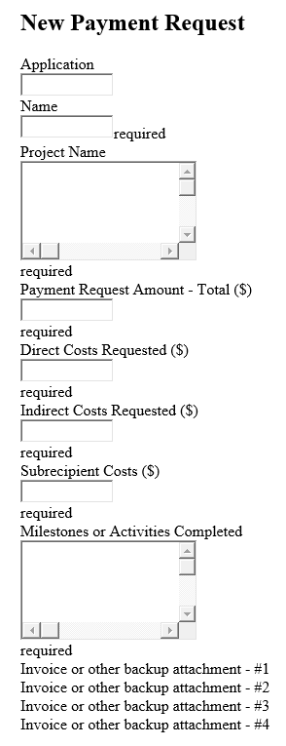
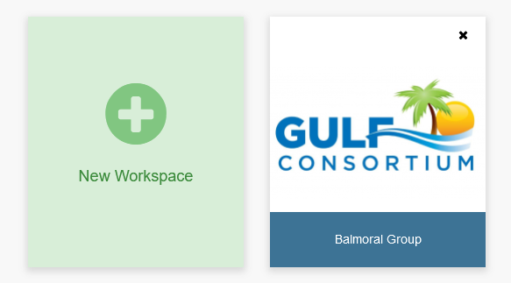
Post-award reporting
https://auth.zenginehq.com/users/login
Payment requests

Slide 22
Post-award reporting
Payment requests; Documentation of county time
(we have a form we’ll provide for comparison to your existing documentation)
Update to Gulf Consortium Grant Manual
“Where an employee works on single or multiple awards (including federal and non-federal), a distribution of their salaries/wages and fringe benefits must be supported by a detailed job cost timesheet showing hourly work effort for all time in a pay period. All work effort must be clearly linked to each project and/or task in the pay period. Pay stubs reflecting total hours must match timesheets and be included in the documentation.
Whenever possible, staff time should be funded by County funds or another source, rather than from direct costs due to the administrative burden.”

Slide 23
SEP amendment #2
The goals of the amendment:
Describe a new project in the SEP for Adaptive Planning (to accommodate SEP amendments, policy revisions, OSA updates, financial audits, and possibly procurements),
Update the original sequencing/timing of funding to reflect changes in Santa Rosa, Okaloosa, and other counties in terms of project order,
Update the cost projections to reflect administrative costs, per RESTORE Council advice and for consistency with grant applications

Slide 24
SEP amendment #2
Please review -
See complete version in Gulf Consortium Board packet at https://www.gulfconsortium.org/2019
See updated milestone tables at
https://datavisual.balmoralgroup.us/GulfConsortiumProjects-Amendment2

Slide 25
Questions…
Contact:
Daniel Dourte
407.629.2185 ext. 113
ddourte@balmoralgroup.us

Slide 26
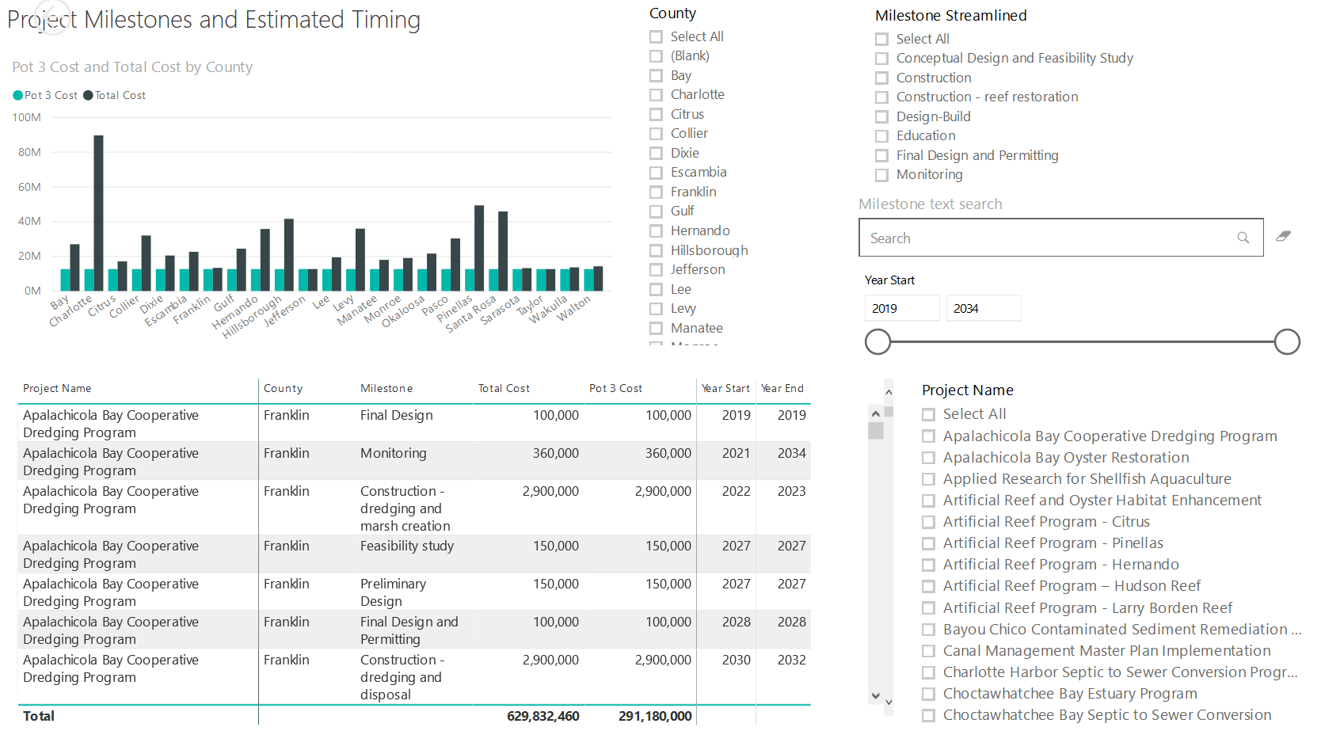
Application Preparation – Implementation Milestones and timing
Dashboard for Project Data
http://datavisual.balmoralgroup.us/GulfConsortiumProjects
milestones, start years, cost, goals, funding sources
GOAL:
Efficient, accurate grant application preparation
Interface for project details
Better, faster decisions on grant timing, readiness, bundling
Transparent tracking of progress and changes

