Slide 1
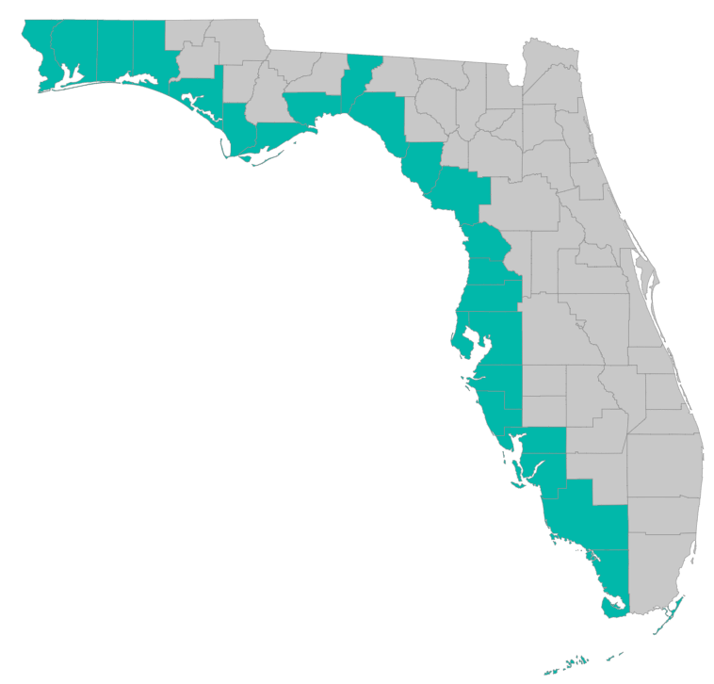

SEP Project Implementation – updates and Q&A
February 18, 2021 – GoToMeeting
Please join my meeting from your computer, tablet or smartphone.
https://global.gotomeeting.com/join/785710869
You can also dial in using your phone.
United States: +1 (312) 757-3119
Access Code: 785-710-869

Slide 2

RESTORE Coordination Meeting – 2/18/2021
Objective: Improve efficiency in project implementation by sharing lessons learned
Identify challenges and solutions in project implementation
Draft Agenda
10 AM: Welcome and Round Robin
Recommendation on what to highlight – focus on what the group could learn from:
Things learned (techniques, procedures, docs, etc) that could benefit other counties
Problems county RESTORE programs are running into that others might have faced, might face in the future
New types of projects that may benefit from different approaches in the RESTORE process
What are you dealing with now that you have questions about or could use help with?
Updates from Treasury
County list: Escambia, Santa Rosa, Okaloosa, Walton, Bay, Gulf, Franklin, Wakulla, Jefferson, Taylor, Dixie, Levy, Citrus, Hernando, Pasco, Hillsborough, Pinellas, Manatee, Sarasota, Charlotte, Collier, Lee, Monroe
11 AM:
Grant application reminders; new templates; BAS documentation
Timeline for grant applications – start now for work you want to start in a year
Post-award reporting, extensions, deliverables, and payment requests
11:30 AM: recommendations for next meeting – what to focus on, topic of interest?

Slide 3
SEP Project Implementation info session agenda
Timeline for grant applications – start now for work you want to start in a year
Grant application reminders; new templates
BAS documentation
Post-award reporting, extensions, deliverables, and payment requests

Slide 4
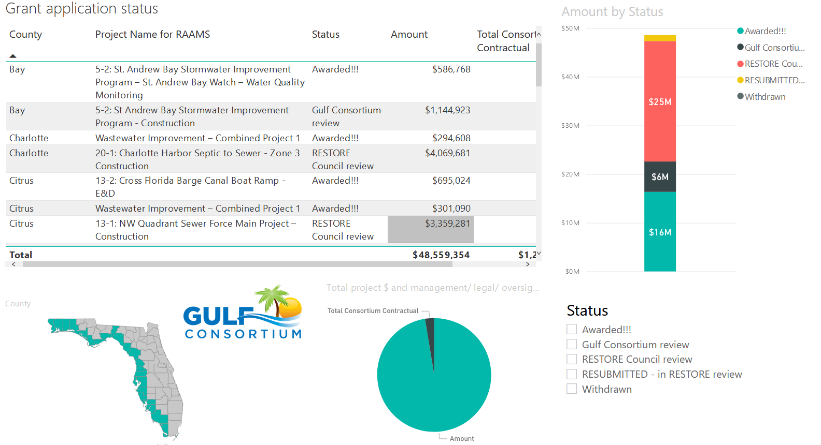
Application Status
Where’s my application, when will an award be made?
http://datavisual.balmoralgroup.us/GulfConsortiumProjects
(p. 8, navigation arrows at bottom)

Slide 5
Application Timeline
Plan for at least 9 months from the time you submit to Gulf Consortium to the time RESTORE Council makes an award
9 months
Application submission to Consortium
Award from RESTORE Council

Slide 6
Application Preparation – guidance
What is needed to submit a subaward application?
See guidance documents and templates at
https://www.gulfconsortium.org/grant-resources
Project Abstract
Project Narrative (BAS)
Project Map (can be picture of pdf or word doc)
Milestone information
Budget Narrative
Budget Table (spreadsheet; SF 424 object class categories)
Leveraged Funding form (don’t need drawdown schedule)
Metrics information (BAS)
Observational Data Plan (BAS)
Data Management Plan (BAS)
Environmental Compliance Checklist
GIS shapefiles (don’t let this hold you up – we can quickly make these)
Recommended order

Slide 7
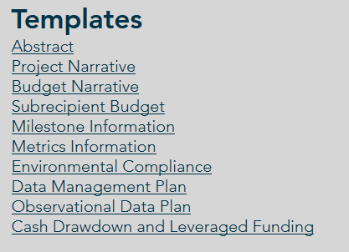
Application Preparation – guidance
What is needed to submit a subaward application?
https://www.gulfconsortium.org/grant-resources
Please use templates: more complete applications = less management cost
Save each of the blank templates; then save as project-specific name and fill them in

Slide 8
Application Preparation – upcoming applications
Next suggested date to submit applications by: 5/28/2021
Don’t need to wait until then – submit whenever you’re ready
What portions of projects can proceed? Anything with a 2019 to 2022 (or maybe even that) start date in the SEP… see http://datavisual.balmoralgroup.us/GulfConsortiumProjects and ask us for help or suggestions

Slide 9
Application Preparation – upcoming applications
IMPORTANT for reducing overhead:
Don’t separate projects into smaller pieces than necessary… every grant/project needs an application and twice-annual performance and financial reports
Look at the most complete tangible deliverable(s) you can complete with the information you have and submit for that milestone(s)

Slide 10
Best Available Science (BAS)
All applications get external BAS review
What we need
Supporting reports or literature that reinforce the project approach and expected impacts
Narrative in Project Narrative that describes how prior studies support the expected project impacts and/or methods
Example (in response to reviewer Q about water quality impacts from living shorelines):
… “Living shorelines are hotspots for a process called denitrification, where microbes remove nitrogen from the terrestrial and aquatic environment by turning it into a gas (N2). This is a two-for-one special for environmentalists, as it decreases the amount of nutrient pollution that ends up in our waterways, while restoring a coastal ecosystem (Onorevole, Thompson, & Piehler, 2018). “

Slide 11
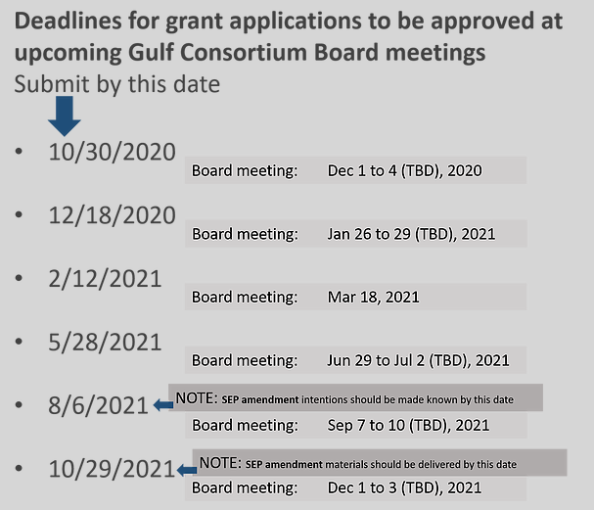
Application Preparation – upcoming applications

Slide 12
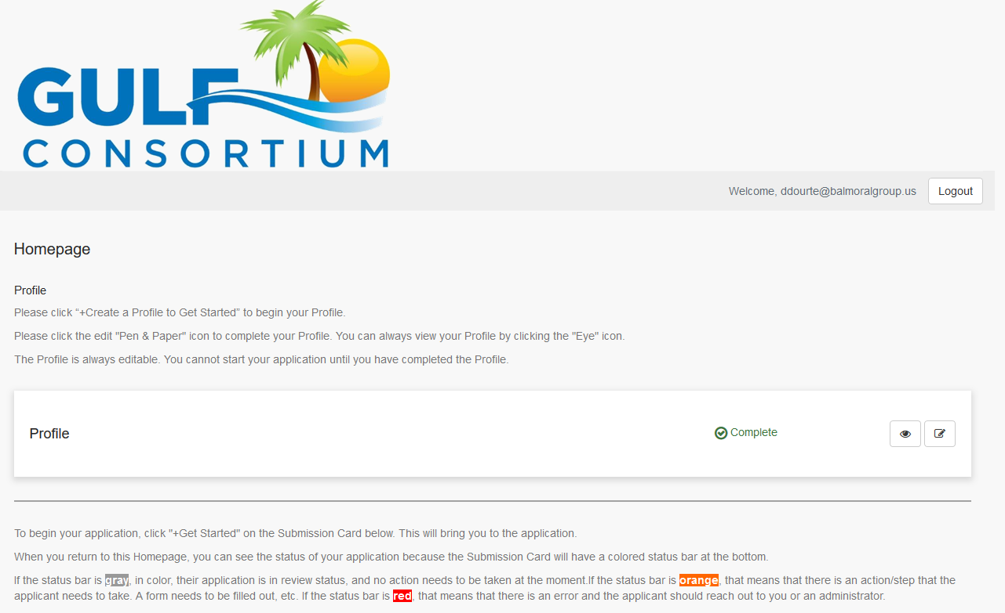
Application Preparation – upcoming applications
How to submit a subaward application? Online at:
https://webportalapp.com/sp/gulfconsortium_sep_projects

Slide 13
Application Preparation – upcoming applications
How to submit a subaward application? Grants mgmt. system
Make a profile
Add an application
Fill out and submit an application
  Use templates locally or on your servers to make complete application attachments before submittal (budget, budget narrative, etc.)
https://webportalapp.com/sp/gulfconsortium_sep_projects

Slide 14
Davis-Bacon Requirements
Required for construction for any “treatment works”
‘Davis-Bacon Act-related provisions are applicable for a construction project if it is for the construction of a project that can be defined as a “treatment works” in 33 U.S.C 1292; and
Davis-Bacon Act-related provisions are applicable for a construction project regardless of whether it is a “treatment works” project if it is receiving federal assistance from another federal agency operating under an authority that requires the enforcement of Davis-Bacon Act-related provisions.’
Example from Dona Bay Hydrologic Restoration – RESTORE Council determined it was not required; the stormwater flow alterations were not interpreted as “treatment works”

Slide 15
Procurement FAQs
See procurement FAQs doc at https://www.gulfconsortium.org/grant-resources
Follow county policies
Be sure procurement is federally compliant (2 CFR 200)
15

Slide 16
Procurement Review
Let Gulf Consortium know about procurement plans
Existing (CCNA) procurements may be allowed, but these need case by case review – see memo from Legal Counsel (NGN)
See “Procurement Information” section at https://www.gulfconsortium.org/grant-resources
Compliance with: 2 CFR § 200.317 - 326

Slide 17
Procurement Review
If you already hired someone to do the work:
Explain the procurement (in Budget Narrative) and past involvement of selected firm (if applicable) and explain 2 CFR 200 compliance
Send procurement backup to Gulf Consortium (ddourte@balmoralgroup.us):
  RFP/RFQ
  Ranking sheet
  Resulting contract
If you will do a new procurement:
Explain the procurement (in Budget Narrative)
Describe compliance with county policies and federal rules
17

Slide 18
Post-award Reporting and Invoicing
Important Links:
Performance Report - https://webportalapp.com/webform/performancereport
Financial Report - https://webportalapp.com/webform/financialreport
Invoicing - https://webportalapp.com/webform/paymentrequest
Deliverables - https://webportalapp.com/webform/deliverables ; plans, permits, reports, data
Next reporting – Financial reports due in April covering the 6-months ending Mar 30 2021

Slide 19
Questions…
Contact:
Daniel Dourte
407.629.2185 ext. 113
ddourte@balmoralgroup.us

Slide 20
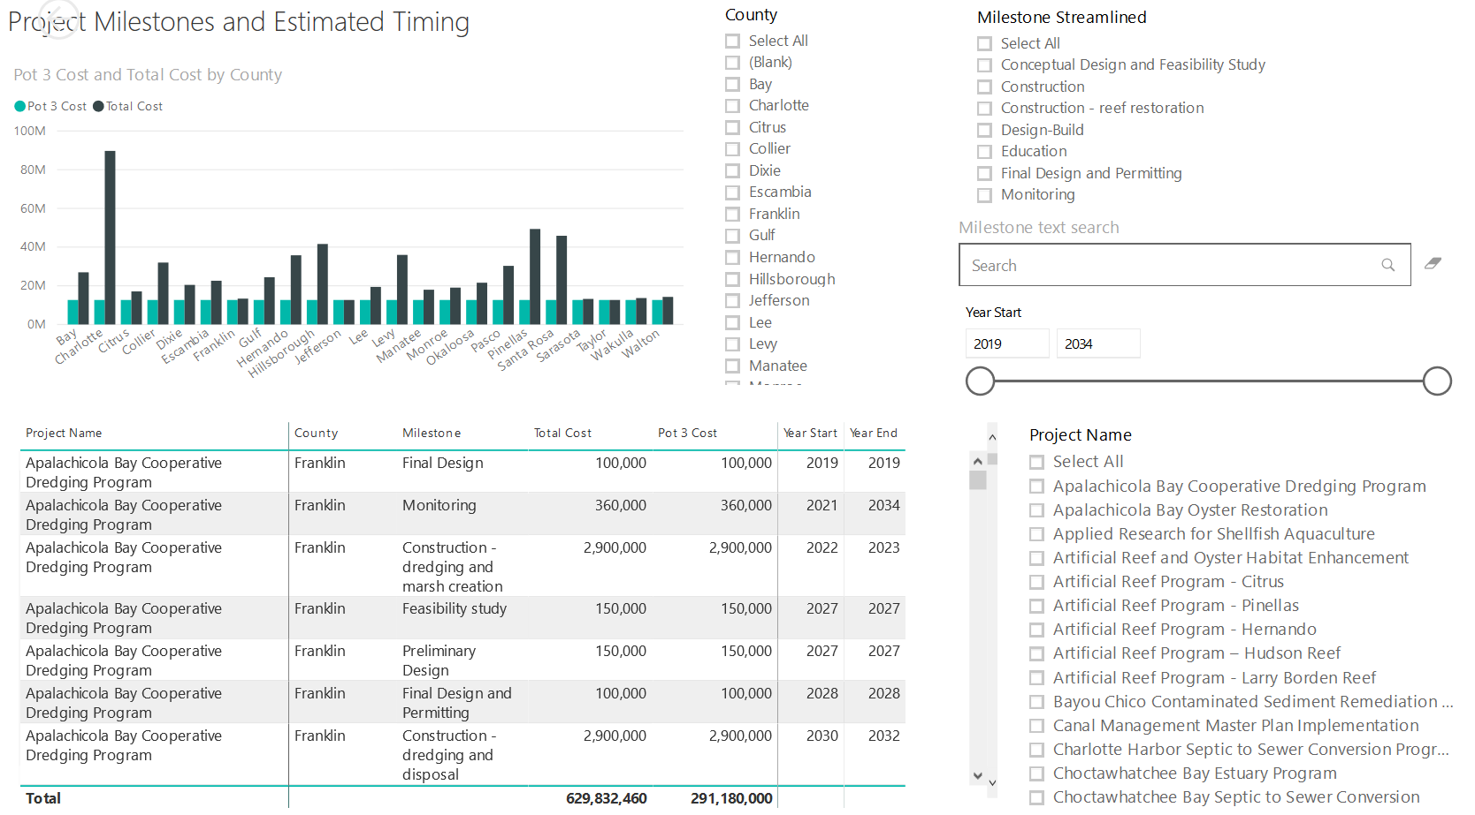
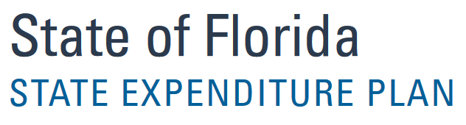
Application Preparation – Implementation Milestones and timing
Dashboard for Project Data
http://datavisual.balmoralgroup.us/GulfConsortiumProjects
milestones, start years, cost, goals, funding sources
GOAL:
Efficient, accurate grant application preparation
Interface for project details
Better, faster decisions on grant timing, readiness, bundling
Transparent tracking of progress and changes

