Slide 1
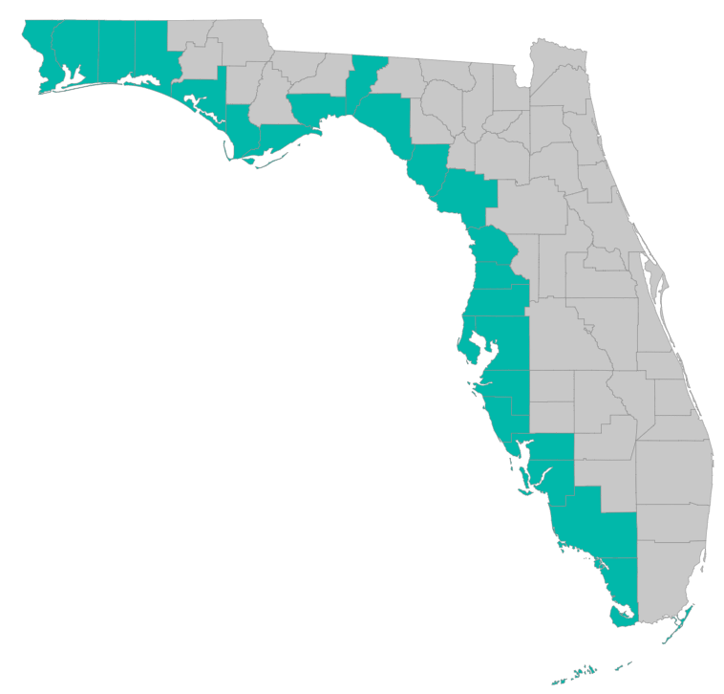

SEP Project Implementation – updates and Q&A
May 1, 2020 – GoToMeeting
Please join my meeting from your computer, tablet or smartphone.
https://global.gotomeeting.com/join/785710869
You can also dial in using your phone.
United States: +1 (312) 757-3119
Access Code: 785-710-869

Slide 2

SEP Project Implementation info session agenda
Grant application status
Checklists, templates, guidance
  https://www.gulfconsortium.org/grant-resources
What applications should proceed
Post-award reporting, invoices, deliverables
Q&A

Slide 3
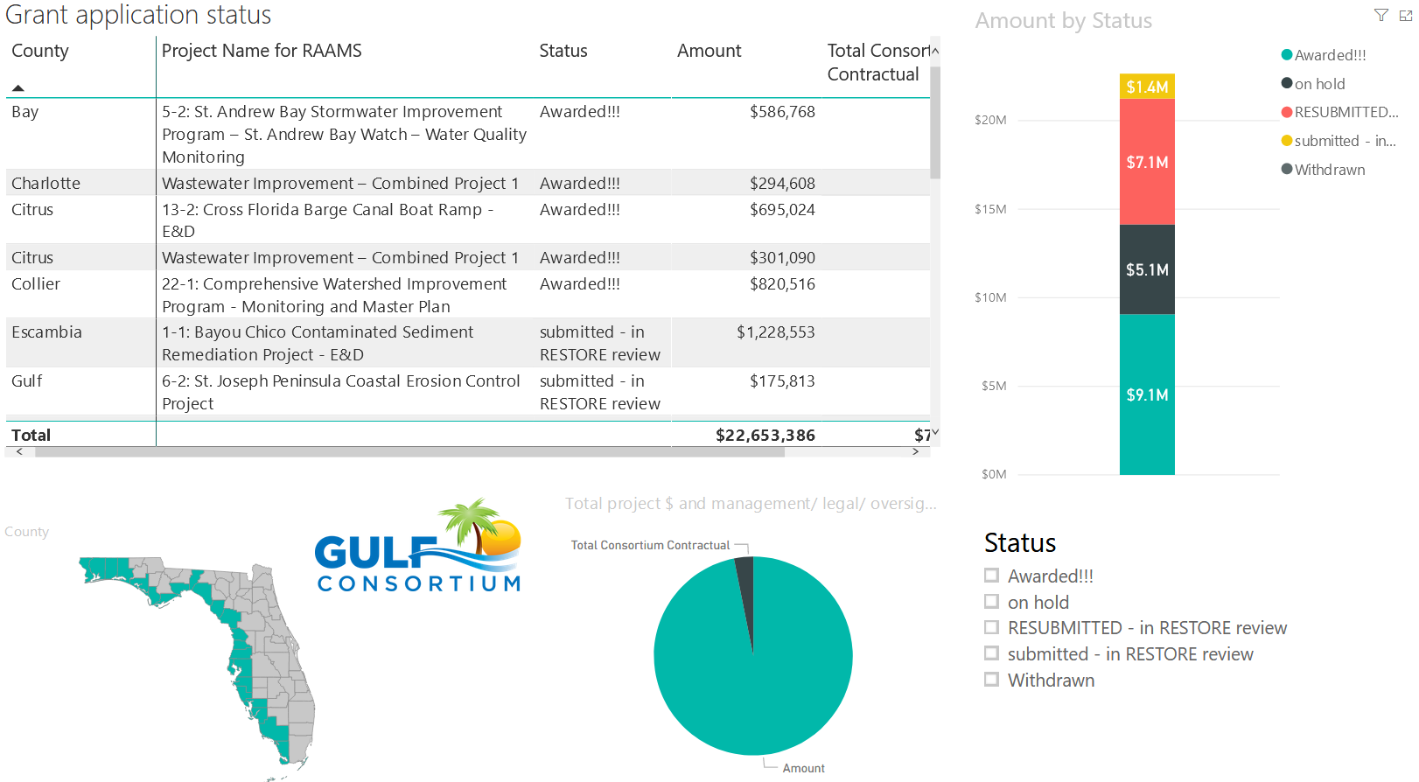
Application Status
Where’s my application, when will an award be made?
http://datavisual.balmoralgroup.us/GulfConsortiumProjects
(p. 8, navigation arrows at bottom)

Slide 4


Application Timeline
How long does it take from Gulf Consortium application to award?
The short answer…
About 5 months:
From Gulf Consortium Board approval to award with sub-recipient agreement
5 to 6 months

Slide 5
Application Preparation – guidance
What is needed to submit a subaward application?
See guidance documents and templates at
https://www.gulfconsortium.org/grant-resources
Project Abstract
Project Narrative (BAS)
Project Map (can be picture of pdf or word doc)
Milestone information
Budget Narrative
Budget Table (spreadsheet; SF 424 object class categories)
Leveraged Funding form (don’t need drawdown schedule)
Metrics information (BAS)
Observational Data Plan (BAS)
Data Management Plan (BAS)
Environmental Compliance Checklist
GIS shapefiles (don’t let this hold you up – we can quickly make these)
Recommended order

Slide 6
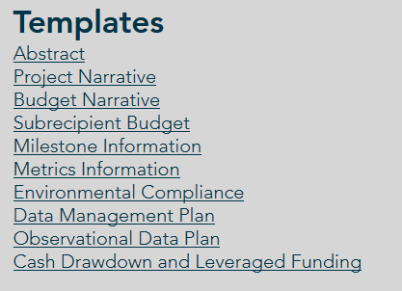
Application Preparation – guidance
What is needed to submit a subaward application?
https://www.gulfconsortium.org/grant-resources
Please use templates: more complete applications = less management cost
Save each of the blank templates; then save as project-specific name and fill them in

Slide 7
Application Preparation – upcoming applications
Next suggested date to submit applications by: 5/15/2020
Don’t need to wait until then – submit whenever you’re ready
What portions of projects can proceed? Anything with a 2019 to 2021 start date in the SEP… see http://datavisual.balmoralgroup.us/GulfConsortiumProjects and ask us for help or suggestions

Slide 8
Application Preparation – upcoming applications
Deadlines for grant applications to be approved at upcoming 2020 Gulf Consortium Board meetings
Submit to Gulf Consortium
By this date
5/15/2020
8/7/2020
10/30/2020
Board meeting June 10, 2020
Board meeting day Sep 8 to 11 (TBD), 2020
Board meeting day Dec 1 to 4 (TBD), 2020

Slide 9
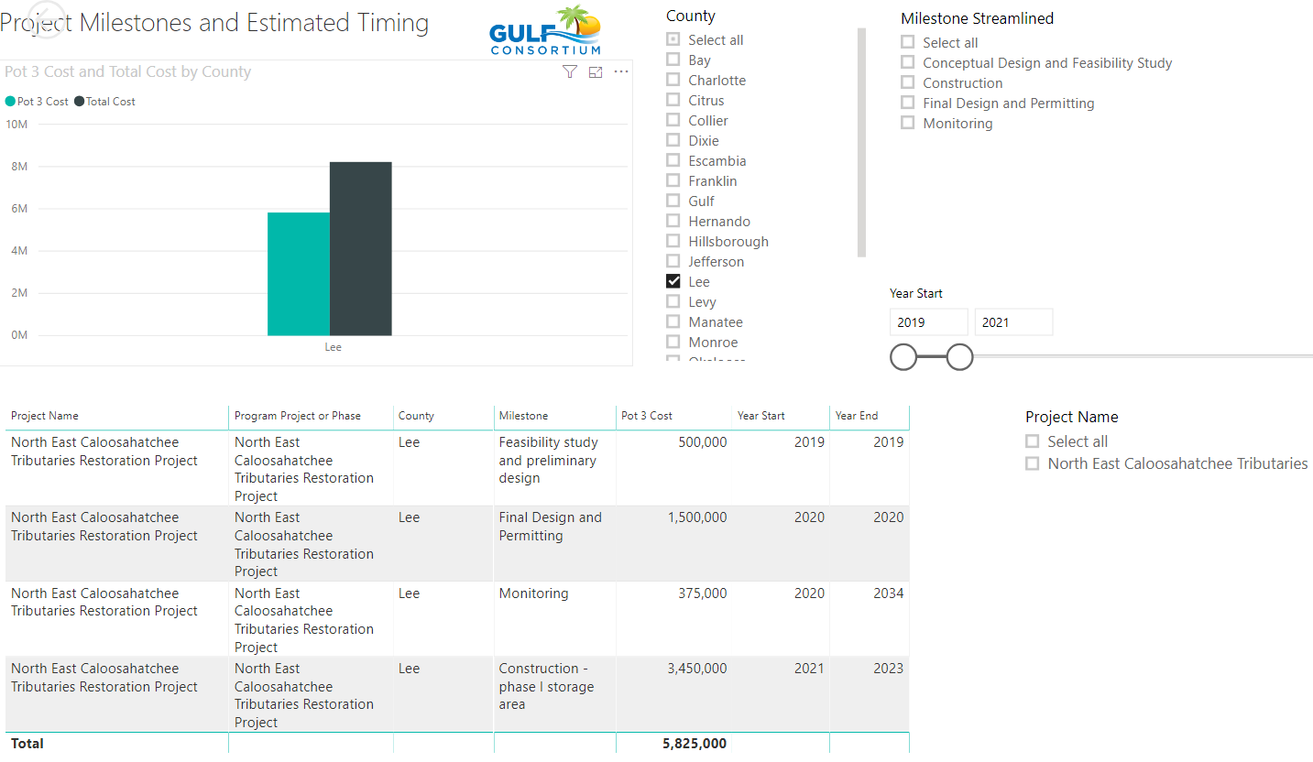

Slide 10
Application Preparation – upcoming applications
IMPORTANT for reducing overhead:
Don’t separate projects into smaller pieces than necessary… every grant/project needs an application and twice-annual performance and financial reports
Look at the most complete tangible deliverable you can complete with the information you have and submit for that milestone(s)

Slide 11
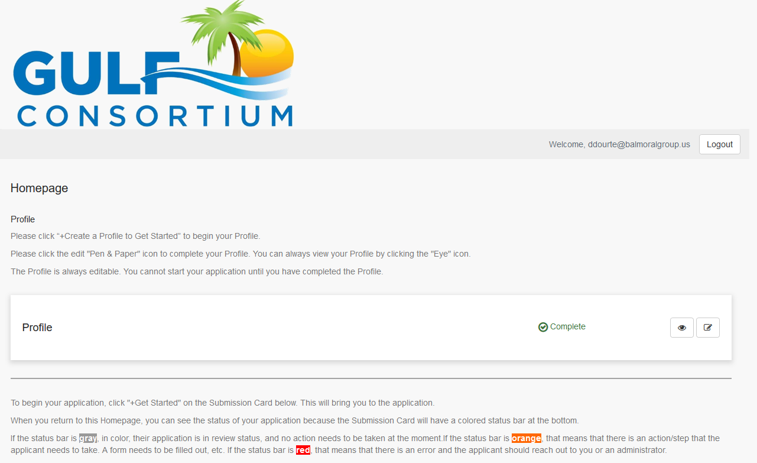
Application Preparation – upcoming applications
How to submit a subaward application? Online at:
https://webportalapp.com/sp/gulfconsortium_sep_projects

Slide 12
Application Preparation – upcoming applications
How to submit a subaward application? Grants mgmt. system
Make a profile
Add an application
Fill out and submit an application
  Use templates locally or on your servers to make complete application attachments before submittal (budget, budget narrative, etc.)
https://webportalapp.com/sp/gulfconsortium_sep_projects

Slide 13
Application Preparation – upcoming applications
Start with templates
https://www.gulfconsortium.org/grant-resources
See example materials
https://drive.google.com/drive/folders/1aELD3bw5M0TqJ2QoghS8EfyguhyqxECb

Slide 14
Award acceptance, agreements, project kickoff
After RESTORE Council makes an award:
  Gulf Consortium reviews and accepts award
    Management and Legal review of award conditions
    Signed by chairman
    Submitted in Council’s grantsolutions
  Sub-recipient agreement established (Gulf Consortium and County) – standard or special conditions
  Gulf Consortium and County meeting to review scope, milestones, budget

Slide 15
Post-award reporting
Due dates table to be provided to subrecipients around time subrecipient agreements are signed
Milestone estimated dates
Financial Report due dates (determined by RESTORE dates specified in award)
Performance Report dates

Slide 16
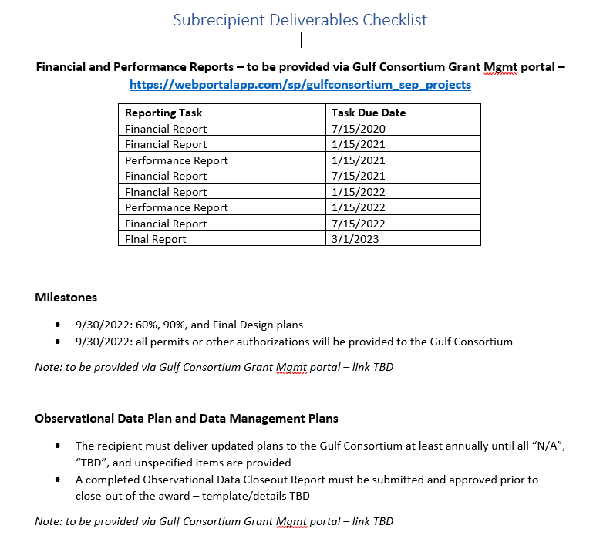

Slide 17
Post-award reporting
Financial and Performance Reports
See example forms at https://www.gulfconsortium.org/grant-resources bottom of page “Example Semi-Annual Report and Payment Request”
  Performance report form
    Form SF-PPR “Performance Progress Report” is basis of performance report form
  Financial report information requests as needed
  Payment request form

Slide 18
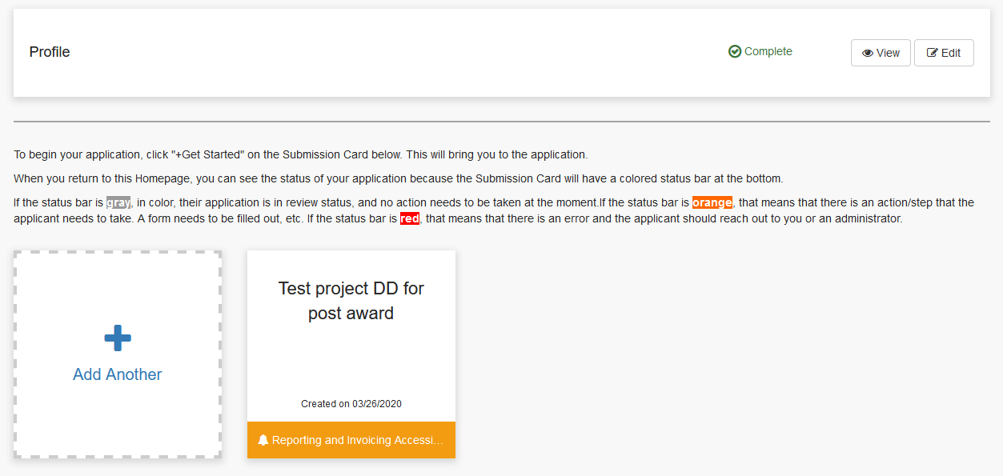
Post-award reporting

Slide 19
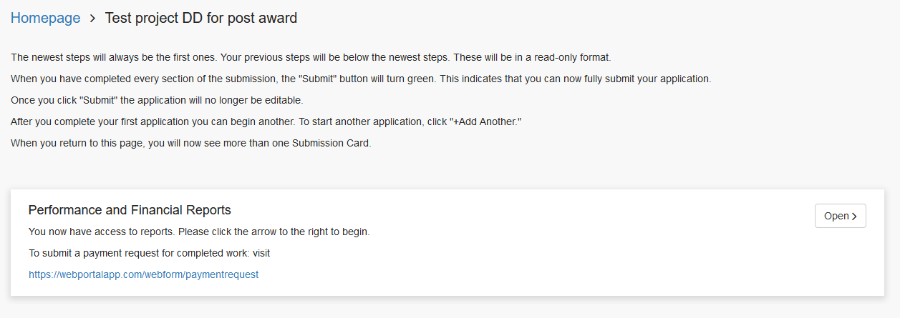
Post-award reporting

Slide 20
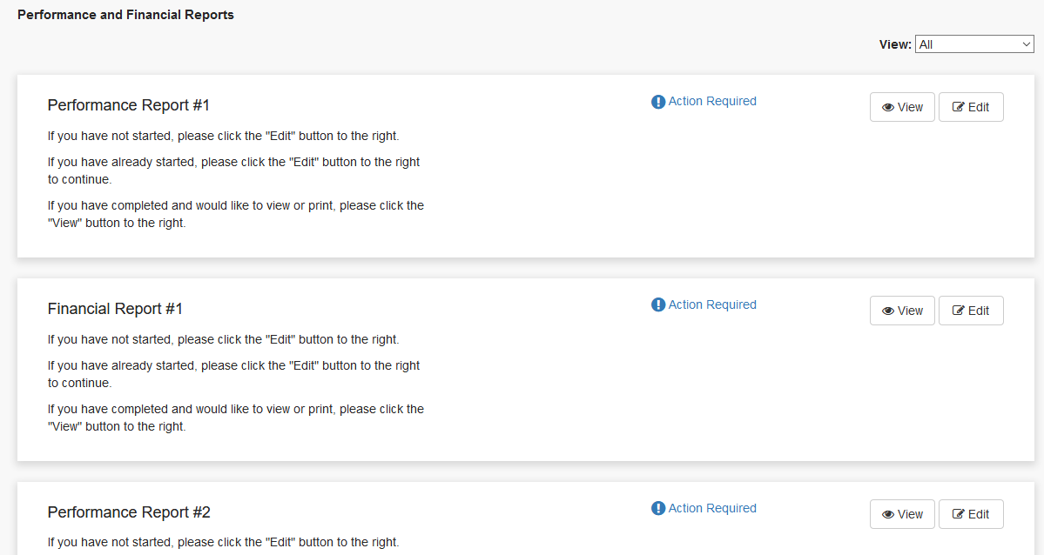
Post-award reporting

Slide 21
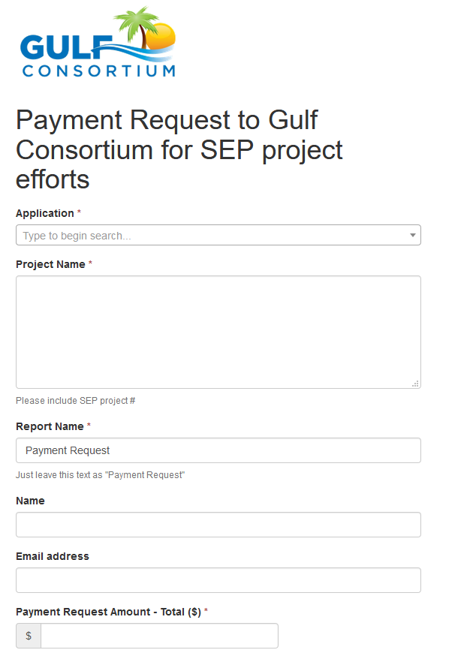
Post-award reporting - invoicing
https://webportalapp.com/webform/paymentrequest
Important – choose correct application in this dropdown box; this will link your invoice to your project
Narrative to describe activities and deliverables;
Attach invoices from contractors and/or timekeeping backup for county staff
Not more often than monthly
Need direct deposit info combined w-9 form for Leon County (fiscal agent)

Slide 22
Post-award reporting - deliverables
https://webportalapp.com/webform/link-TBD
Web form to attach deliverables (coming soon)
Plans
Permits
Site visit pictures or reports
Observational data
others

Slide 23
Questions…
Contact:
Daniel Dourte
407.629.2185 ext. 113
ddourte@balmoralgroup.us

Slide 24
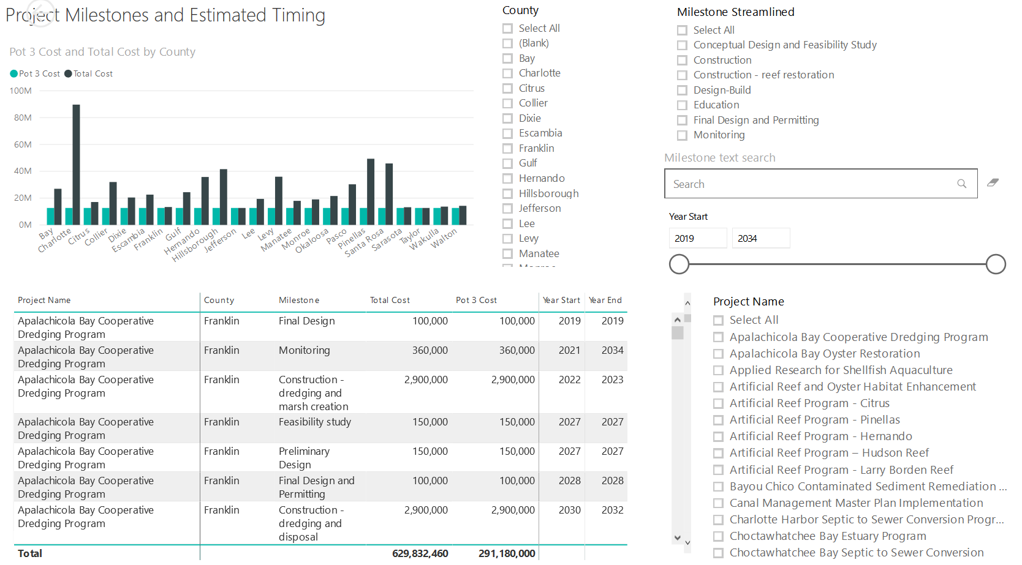

Application Preparation – Implementation Milestones and timing
Dashboard for Project Data
http://datavisual.balmoralgroup.us/GulfConsortiumProjects
milestones, start years, cost, goals, funding sources
GOAL:
Efficient, accurate grant application preparation
Interface for project details
Better, faster decisions on grant timing, readiness, bundling
Transparent tracking of progress and changes

