Slide 1
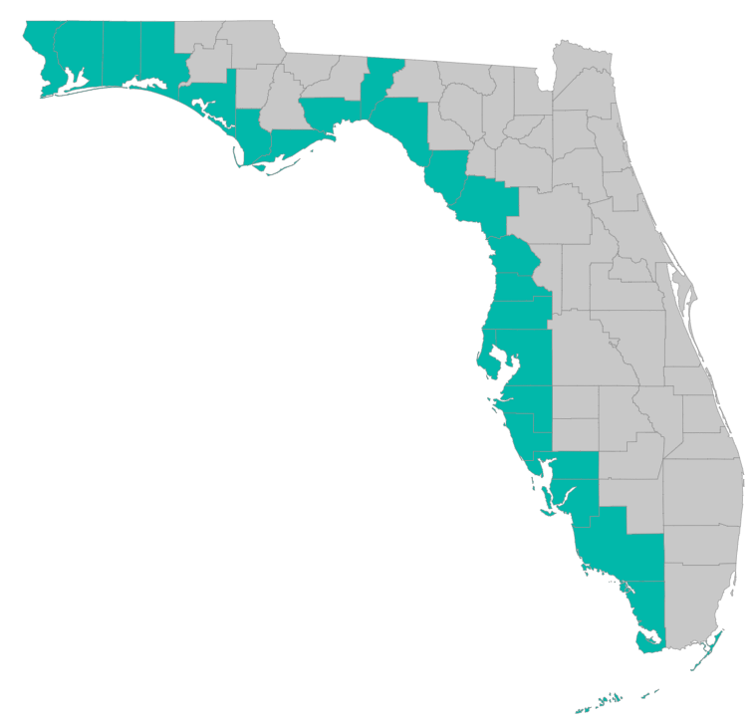
SEP Project Implementation – updates and Q&A
September 29, 2020 – GoToMeeting
Please join my meeting from your computer, tablet or smartphone. https://global.gotomeeting.com/join/785710869 You can also dial in using your phone. United States: +1 (312) 757-3119 Access Code: 785-710-869

Slide 2
RESTORE Coordination Meeting – 9/29/2020
Objective: Improve efficiency in project implementation by sharing lessons learned
Identify challenges and solutions in project implementation
Draft Agenda
10 AM: Welcome and Round Robin
Recommendation on what to highlight – focus on what the group could learn from:
Things learned (techniques, procedures, docs, etc) that could benefit other counties
Problems county RESTORE programs are running into that others might have faced, might face in the future
New types of projects that may benefit from different approaches in the RESTORE process
What are you dealing with now that you have questions about or could use help with?
- Updates from Treasury
County list: Escambia, Santa Rosa, Okaloosa, Walton, Bay, Gulf, Franklin, Wakulla, Jefferson, Taylor, Dixie, Levy, Citrus, Hernando, Pasco, Hillsborough, Pinellas, Manatee, Sarasota, Charlotte, Collier, Lee, Monroe
10:45 AM:
Grant application reminders; new templates
SEP amendment – materials due 10/23/2020
Revisions to Uniform Guidance – effective Nov. 1 2020
Procurement guidance – new, existing, and continuing services
Post-award reporting, extensions, deliverables, and payment requests
Statewide data repositories: WIN and Water-CAT
11:30 AM: recommendations for Dec meeting – what to focus on, topic of interest?

Slide 3
SEP Project Implementation info session agenda
Grant application status
Checklists, templates, guidance
https://www.gulfconsortium.org/grant-resources
What applications should proceed
Post-award reporting, invoices, deliverables
Q&A

Slide 4
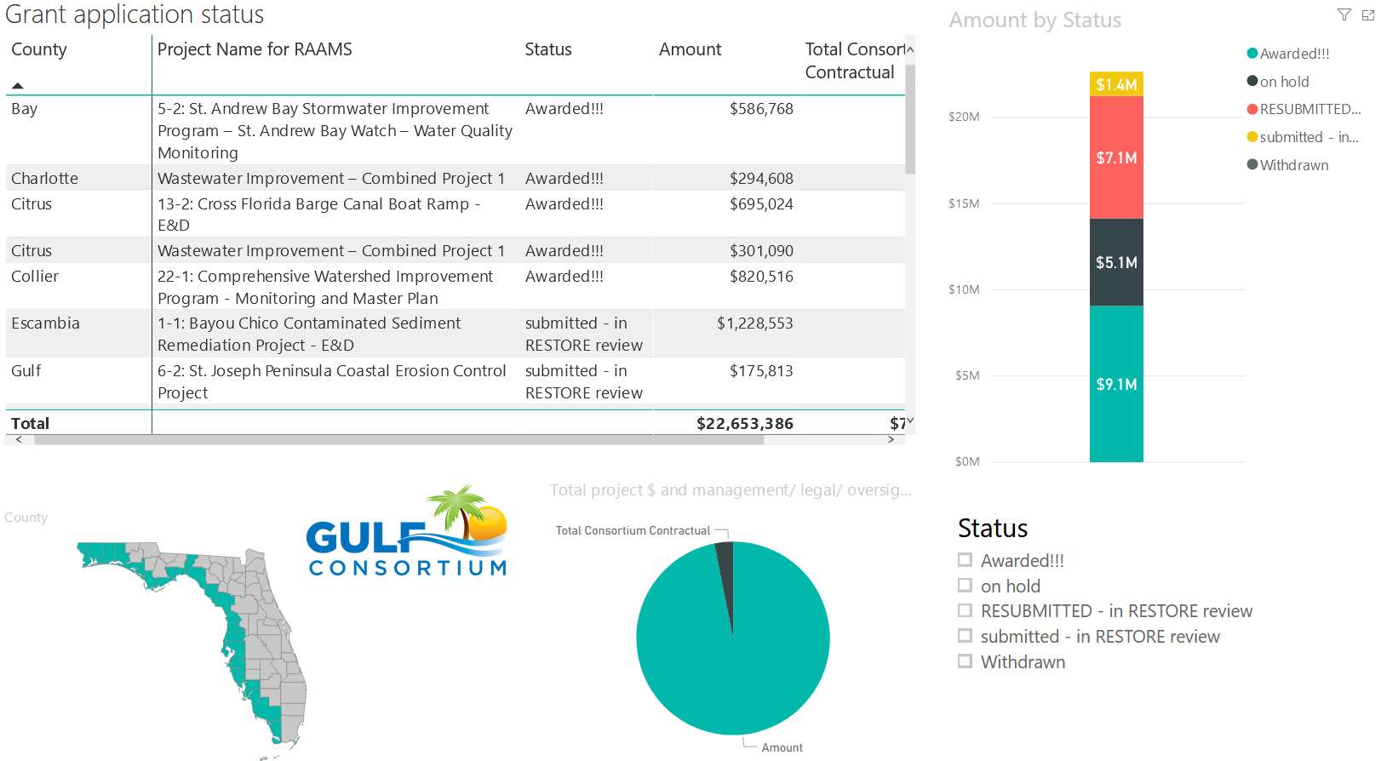
Application Status
Where’s my application, when will an award be made?
http://datavisual.balmoralgroup.us/GulfConsortiumProjects
(p. 8, navigation arrows at bottom)

Slide 5
Application Preparation – guidance
What is needed to submit a subaward application?
See guidance documents and templates at
https://www.gulfconsortium.org/grant-resources
Project Abstract
Project Narrative (BAS)
Project Map (can be picture of pdf or word doc)
Milestone information
Budget Narrative
Budget Table (spreadsheet; SF 424 object class categories)
Leveraged Funding form (don’t need drawdown schedule)
Metrics information (BAS)
Observational Data Plan (BAS)
Data Management Plan (BAS)
Environmental Compliance Checklist
GIS shapefiles (don’t let this hold you up – we can quickly make these)
Recommended order

Slide 6
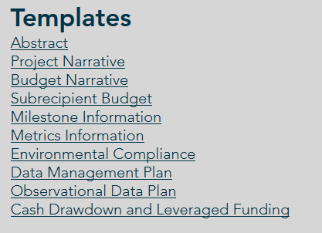
Application Preparation – guidance
What is needed to submit a subaward application?
https://www.gulfconsortium.org/grant-resources
Please use templates: more complete applications = less management cost
Save each of the blank templates; then save as project-specific name and fill them in

Slide 7
Application Preparation – upcoming applications
Next suggested date to submit applications by: 10/30/2020
Don’t need to wait until then – submit whenever you’re ready
What portions of projects can proceed? Anything with a 2019 to 2022 (or maybe even that) start date in the SEP… see http://datavisual.balmoralgroup.us/GulfConsortiumProjects and ask us for help or suggestions

Slide 8
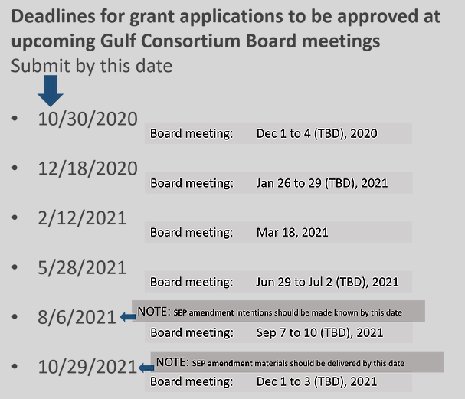
Application Preparation – upcoming applications

Slide 9
Application Preparation – upcoming applications
IMPORTANT for reducing overhead:
Don’t separate projects into smaller pieces than necessary… every grant/project needs an application and twice-annual performance and financial reports
Look at the most complete tangible deliverable(s) you can complete with the information you have and submit for that milestone(s)

Slide 10
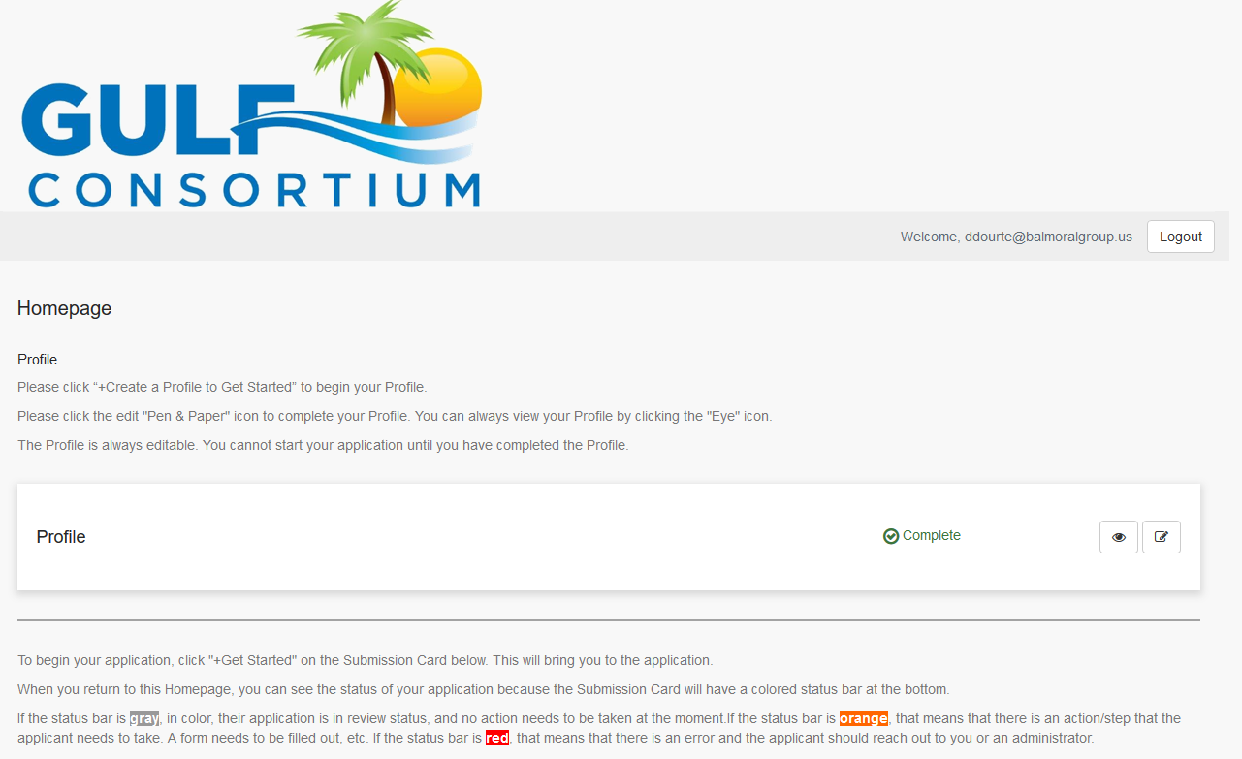
Application Preparation – upcoming applications
How to submit a subaward application? Online at:
https://webportalapp.com/sp/gulfconsortium_sep_projects

Slide 11
Application Preparation – upcoming applications
How to submit a subaward application? Grants mgmt. system
Make a profile
Add an application
Fill out and submit an application
Use templates locally or on your servers to make complete application attachments before submittal (budget, budget narrative, etc.)
https://webportalapp.com/sp/gulfconsortium_sep_projects

Slide 12
SEP Amendment #3
Please send materials by 10/23/2020
See template at bottom of page:
https://www.gulfconsortium.org/grant-resources
December Gulf Consortium Board meeting – get approval of the actual draft SEP amendment
December 2 or 3; release the draft SEP amendment for mandatory 45-day public comment period
Late January 2021 – respond to public comments and make SEP amendment edits and then submit to RESTORE Council for their 60-day review (that’s the max. time they have to approve it)
End of March 2021 – hopefully the SEP amendment is fully approved by RESTORE Council

Slide 13
Changes to 2 CFR 200
Changes in effect Nov. 12, 2020
Changes in effect Aug. 13, 2020 for 2 CFR §200.216 & 200.340
Currently identifying which section changes will impact Gulf Consortium

Slide 14
Post Award Compliance Review (Treasury and OCRD)
The Office of Civil Rights and Diversity’s (OCRD) Post-Award Compliance: Review Documentation Request
Civil Rights Contacts.
Assurance Agreement or Assurances of Non-discrimination
Notices to beneficiaries (i.e., notice of how to file a complaint)
Website information (i.e., the URLs to their main website, to any civil rights notices posted on their website, and to web pages in any other languages).
Information about pending lawsuits or complaints alleging discrimination.
Post-award compliance review reports for the past 2 years.
Language Access Plan. What steps is the recipient taking to provide language access to the members of the public who are limited English proficient?
Language Access Services Notice. What steps is the recipient taking to notify the public about the availability of language services?
Copy of any Board’s bylaws.
Participation data by race and national origin.
Copies of applications for benefits and services in use by the recipient.
Policies for the financial assistance programs.
Copy of the recipient’s Strategic or Business Plan.
Copy of the recipient’s Outreach Plan.
Program marketing information, such as, brochures.

Slide 15
Procurement FAQs
See procurement FAQs doc at https://www.gulfconsortium.org/grant-resources
Follow county policies
Be sure procurement is federally compliant (2 CFR 200)
15

Slide 16
Procurement Review
Let Gulf Consortium know about procurement plans
Existing (CCNA) procurements may be allowed, but these need case by case review – see memo from Legal Counsel (NGN)
Compliance with: 2 CFR § 200.317 - 326

Slide 17
Procurement Review
If you already hired someone to do the work:
Explain the procurement (in Budget Narrative) and past involvement of selected firm (if applicable) and explain 2 CFR 200 compliance
Send procurement backup to Gulf Consortium (ddourte@balmoralgroup.us):
RFP/RFQ
Ranking sheet
Resulting contract
If you will do a new procurement:
Explain the procurement (in Budget Narrative)
Describe compliance with county policies and federal rules
17

Slide 18
Post-award reporting
Due dates table to be provided to subrecipients around time subrecipient agreements are signed
Milestone estimated dates
Financial Report due dates (determined by RESTORE dates specified in award)
Performance Report dates

Slide 19
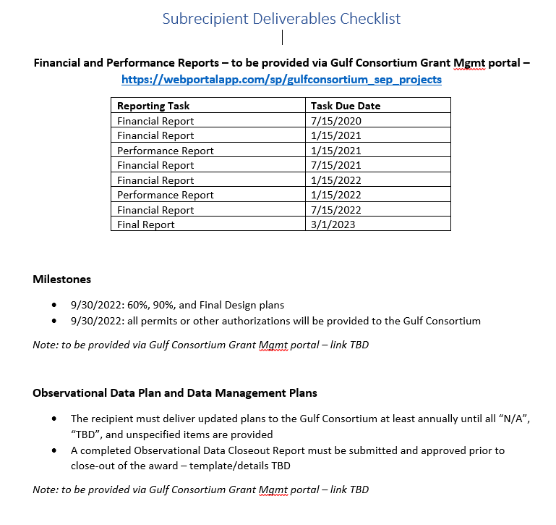

Slide 20
Post-award reporting – performance reports; deliverables
Performance report form – see form at https://www.gulfconsortium.org/grant-resources
​ Reports should be submitted through the grant management portal: https://webportalapp.com/webform/performancereport
Deliverables (engineering plans, reports, observational data…)
https://webportalapp.com/webform/deliverables
​

Slide 21
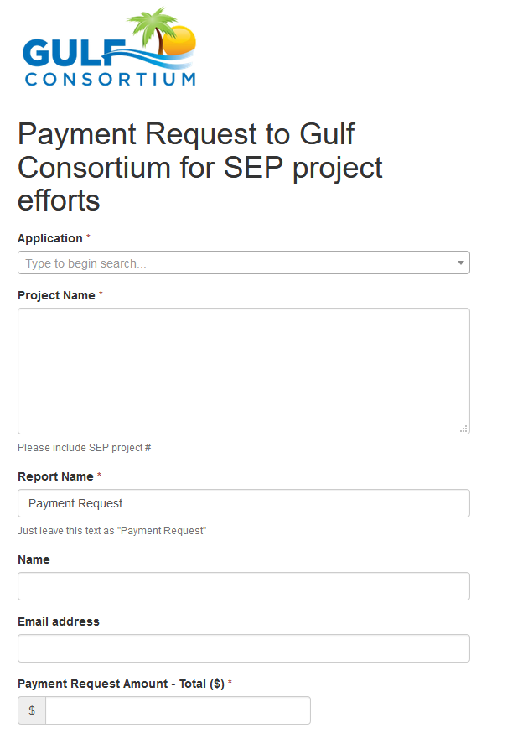
Post-award reporting - invoicing
https://webportalapp.com/webform/paymentrequest
Important – choose correct application in this dropdown box; this will link your invoice to your project
Narrative to describe activities and deliverables;
Attach invoices from contractors and/or timekeeping backup for county staff
Not more often than monthly
Need direct deposit info combined w-9 form for Leon County (fiscal agent)

Slide 22
Questions…
Contact:
Daniel Dourte
407.629.2185 ext. 113
ddourte@balmoralgroup.us

Slide 23
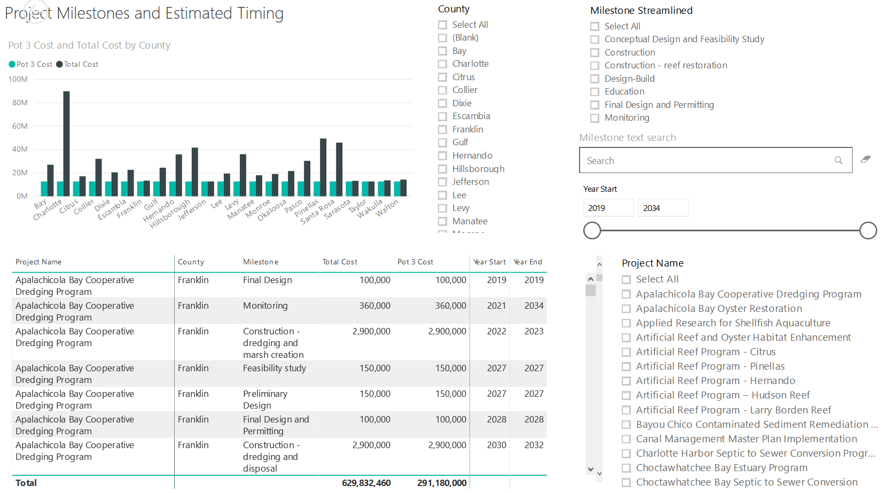
Application Preparation – Implementation Milestones and timing
Dashboard for Project Data
http://datavisual.balmoralgroup.us/GulfConsortiumProjects
milestones, start years, cost, goals, funding sources
GOAL:
Efficient, accurate grant application preparation
Interface for project details
Better, faster decisions on grant timing, readiness, bundling
Transparent tracking of progress and changes

