Slide 1
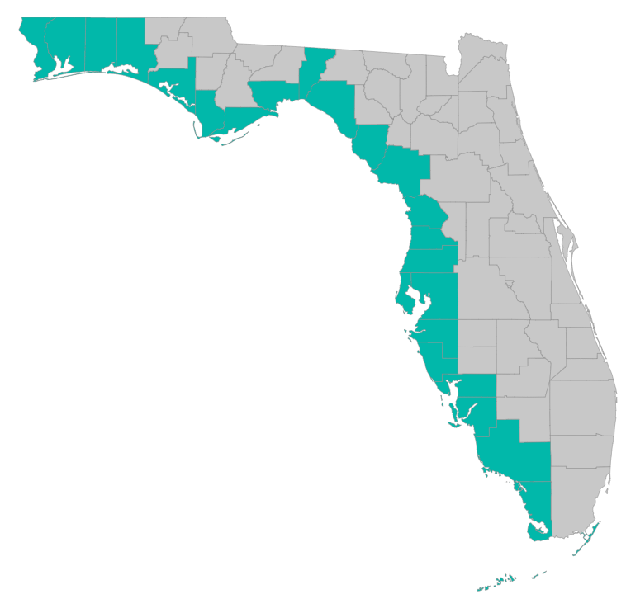
SEP Project Implementation – updates and Q&A
September 29, 2021 – GoToMeeting
Please join my meeting from your computer, tablet or smartphone. https://global.gotomeeting.com/join/785710869 You can also dial in using your phone. United States: +1 (312) 757-3119 Access Code: 785-710-869

Slide 2
RESTORE Coordination Meeting – 9/29/2021
Objectives:
Improve efficiency in project implementation by sharing lessons learned
Identify challenges and solutions in project implementation
Draft Agenda
10 AM: Welcome and Round Robin
Recommendation on what to highlight – focus on what the group could learn from:
Things learned (techniques, procedures, docs, etc) that could benefit other counties
Problems county RESTORE programs are running into that others might have faced, might face in the future
New types of projects that may benefit from different approaches in the RESTORE process
What are you dealing with now that you have questions about or could use help with?
County list: Escambia, Santa Rosa, Okaloosa, Walton, Bay, Gulf, Franklin, Wakulla, Jefferson, Taylor, Dixie, Levy, Citrus, Hernando, Pasco, Hillsborough, Pinellas, Manatee, Sarasota, Charlotte, Collier, Lee, Monroe
10:45 AM: RESTORE Council, Treasury, and FDEP updates as needed
11:15 AM: SEP project implementation discussion
Grant application reminders, examples; templates
SEP amendment: changing projects, generalizing locations, updating costs
Procurement reviews and MBE outreach
Post-award reporting and monitoring: financial and performance oversight meetings, selected site visits; closeout reporting
11:45 AM: Recommendations for next meeting – what to focus on, topic of interest?

Slide 3
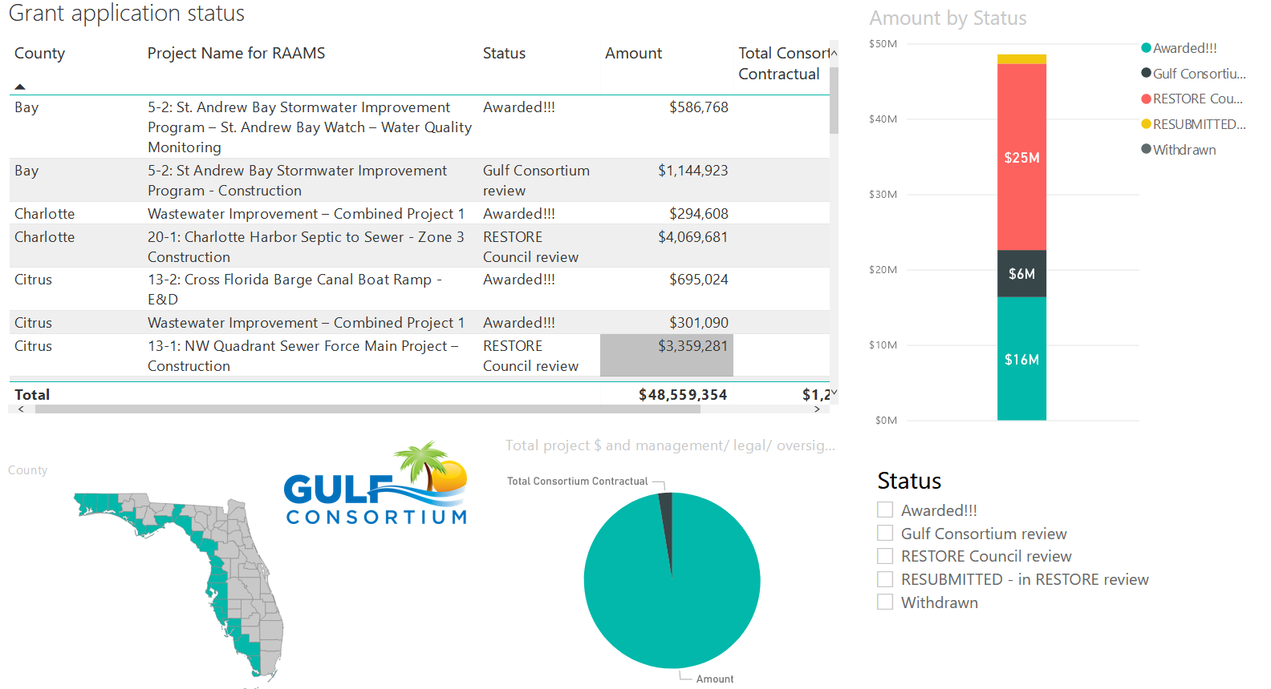
Application Status
Where’s my application, when will an award be made?
http://datavisual.balmoralgroup.us/GulfConsortiumProjects
(p. 8, navigation arrows at bottom)

Slide 4
Application Timeline
Plan for at least 9 months from the time you submit to Gulf Consortium to the time RESTORE Council makes an award
9 months
Application submission to Consortium
Award from RESTORE Council

Slide 5
Application Preparation – guidance
What is needed to submit a subaward application?
See guidance documents and templates at
https://www.gulfconsortium.org/grant-resources
Project Abstract
Project Narrative (BAS)
Project Map (can be picture of pdf or word doc)
Milestone information (spreadsheet; include deliverables)
Budget Narrative
Budget Table (spreadsheet; SF 424 object class categories)
Leveraged Funding form (don’t need drawdown schedule)
Metrics information (BAS)
Observational Data Plan (BAS)
Data Management Plan (BAS)
Environmental Compliance Checklist
GIS shapefiles – or map/picture (don’t let this hold you up – we can quickly make these)
Recommended order

Slide 6
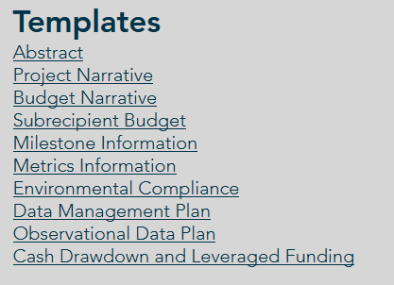
Application Preparation – guidance
What is needed to submit a subaward application?
https://www.gulfconsortium.org/grant-resources
Please use templates: more complete applications = less management cost
Save each of the blank templates; then save as project-specific name and fill them in

Slide 7
Application Preparation – upcoming applications
Next suggested date to submit applications by: 10/15/2021
Don’t need to wait until then – submit whenever you’re ready
What portions of projects can proceed? Anything with a 2019 to 2023 (or maybe even after that) start date in the SEP… see http://datavisual.balmoralgroup.us/GulfConsortiumProjects and ask us for help or suggestions

Slide 8
Application Preparation – upcoming applications
IMPORTANT for reducing overhead:
Don’t separate projects into smaller pieces than necessary… every grant/project needs an application and twice-annual performance and financial reports

Slide 9
Cost Escalation
How to get costs right at grant application stage...
Don’t rely on SEP estimated $
Do internal cost analysis
If you have an engineer’s estimate of construction costs – can(should) it be updated?
Goal: minimize amendments to awards and to the SEP
9

Slide 10
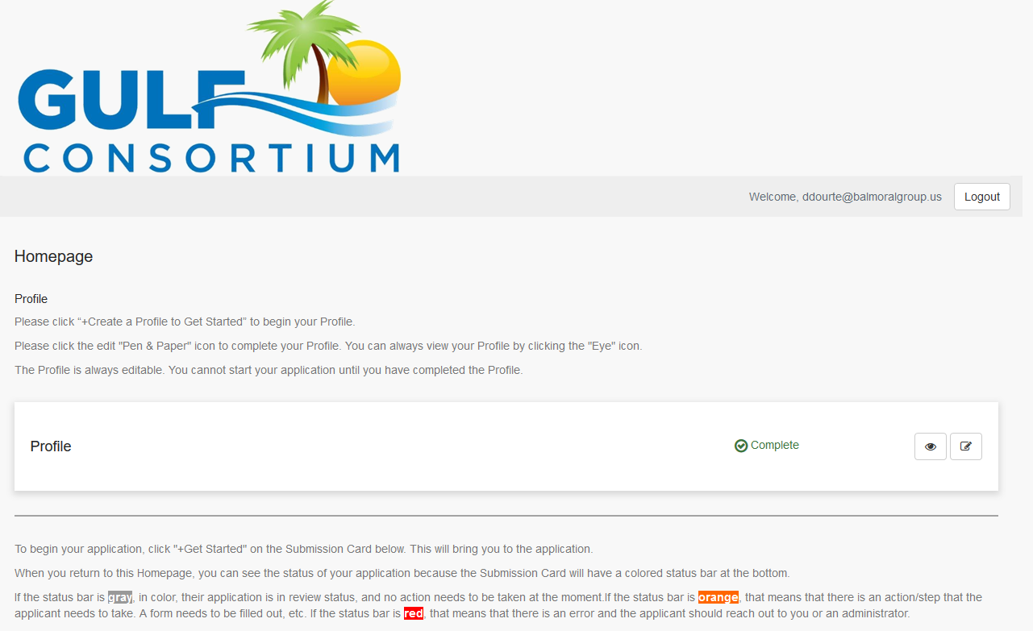
Application Preparation – upcoming applications
How to submit a subaward application? Online at:
https://webportalapp.com/sp/gulfconsortium_sep_projects

Slide 11
Application Preparation – upcoming applications
How to submit a subaward application? Grants mgmt. system
Make a profile
Add an application
Fill out and submit an application
Use templates locally or on your servers to make complete application attachments before submittal (budget, budget narrative, etc.)
https://webportalapp.com/sp/gulfconsortium_sep_projects

Slide 12
SEP Amendment #4
Please send materials by 10/15/2021
See template at bottom of page:
https://www.gulfconsortium.org/grant-resources
November Gulf Consortium Board meeting – get approval of the actual draft SEP amendment
Week of Nov. 22: release the draft SEP amendment for mandatory 45-day public comment period
Late January 2022 – respond to public comments and make SEP amendment edits and then submit to RESTORE Council (after Consortium Board approval for their 60-day review (that’s the max. time they have to approve it)
End of March 2022 – SEP amendment should be fully approved by RESTORE Council

Slide 13
SEP Amendment #4
What to change?
New projects to add
Scope changes for existing projects
Locations for existing projects to describe more generally
Existing projects to remove if they are no longer to be funded by Bucket 3
Changing costs: if you know projects will cost more than the amounts estimated in the SEP, we need to make those changes to ensure that the projects that go away or get reduced $ are documented and
See example SEP amendments here:
https://www.gulfconsortium.org/state-expenditure-plan

Slide 14
Procurement FAQs
See procurement FAQs doc at https://www.gulfconsortium.org/grant-resources
Follow county policies
Be sure procurement is federally compliant (2 CFR 200)
14

Slide 15
Procurement Review
Let Gulf Consortium know about procurement plans
Existing (CCNA) procurements may be allowed, but these need case by case review
See “Procurement Information” section at https://www.gulfconsortium.org/grant-resources
Compliance with: 2 CFR § 200.317 - 326

Slide 16
Procurement Review
These procurement documents need to be provided to Gulf Consortium management and legal:
Explain the procurement (in Budget Narrative) and past involvement of selected firm (if applicable) and explain 2 CFR 200 compliance
Send procurement backup to Gulf Consortium (ddourte@balmoralgroup.us; erosenthal@ngn-tally.com):
RFP/RFQ
Ranking sheet
Resulting contract
Documentation of MBE outreach
For grant applications:
Explain the procurement (in Budget Narrative), whether planned or past
Describe compliance with county policies and federal rules
16

Slide 17
Procurement Review – example MBE outreach
Good Morning:
In accordance with Palm Beach County Policy and Procedure Manual (PPM) CW-L-049 and 2CFR Parts 200.317 – 200.326 (“Super Circular”) for goods and services to be purchased with federal funds, all necessary affirmative steps shall be taken to ensure that small and minority businesses, women business enterprises, and labor and surplus area firms are solicited whenever they are potential sources and are to be utilized whenever possible.
Please be advised that the Office of Equal Business Opportunity (OEBO) shall on the date the solicitation is to be advertised distribute an email to all small, minority and women business enterprises advising them to check the County’s website for County business opportunities utilizing federal funds. In accordance with the polices as stated above, you are receiving this notice. As a courtesy, OEBO has included a copy of the solicitation with this notice.
Attached you will find a copy of RFP NO F-21-047/IM for your consideration. Companies shall be reminded that in order to do business with Palm Beach County, vendors are required to create a Vendor Registration Account or activate an existing Vendor Registration Account through the Purchasing Department’s Vendor Self Service (VSS) system at https://pbcvssp.co.palm-beach.fl.us/webapp/vssp/AltSelfService. Please click on the public access tab to view the attached solicitation. As amendments to solicitations are issued, they will be posted under the applicable solicitation on VSS. It is the vendor’s sole responsibility to routinely check VSS for an amendments or notifications that may be issued prior to the deadline for receipt of proposals.
17

Slide 18
Procurement Review – MBE outreach
If you don’t have an MBE distribution list – check with your local small business organization or FDOT
18

Slide 19
Post-award Reporting and Invoicing
Important Links:
Performance Report - https://webportalapp.com/webform/performancereport
Financial Report - https://webportalapp.com/webform/financialreport
Invoicing - https://webportalapp.com/webform/paymentrequest
Deliverables - https://webportalapp.com/webform/deliverables ; plans, permits, reports, data

Slide 20
Post-award Reporting and Invoicing
Performance Report template at https://www.gulfconsortium.org/grant-resources
Let us know right away if you’re behind schedule or if there’s a major change in your project
Update your ODP
Financial Report template provided to subrecipients by email for 1st report, then it is updated for future reports

Slide 21
Post-award Reporting
Performance Reports: minimum 1/year
NEW – yearly project status meetings (6 months away from the yearly, written submission)
More detailed project performance interviews – based on milestones review and evidence of progress on milestones (for moderate and high risk projects)
Financial Reports: minimum 2/year
NEW – more frequent, detailed financial reviews for moderate or high risk counties

Slide 22
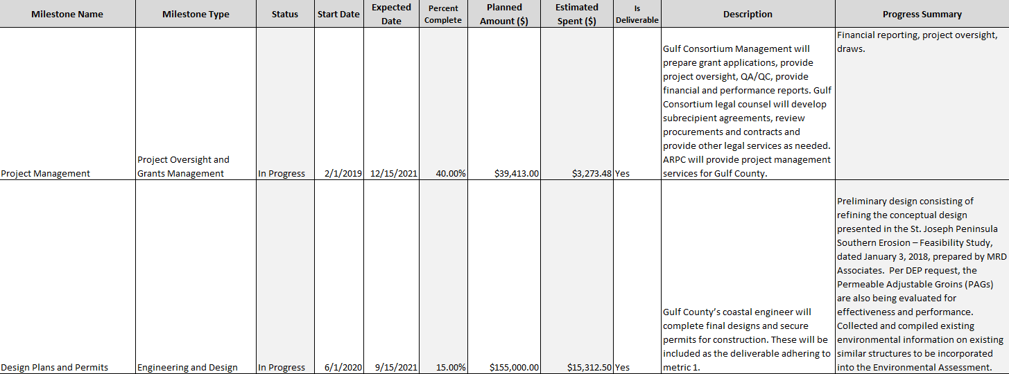
Post-award Reporting – progress review
More detail required to show evidence of progress on milestones

Slide 23
Post-award Reporting – financial monitoring
Award Accepted
Set up files & reports
Set up G/L Accounts
Folder: EGID# County
Example:
91 16-1 Pinellas
Items within the folder are Drawdowns & Financial Reports
Reports:
FSEP Grant Finance Tracking
Budget Summary
Budget Detail
Draw Summary
Milestones
Financial Report Schedule
Report Due Dates
Report Progress Tracking
G/L Account Example
4300 Grant Funds SEP (Revenue)
43091 Lake Seminole Funds
8000 SEP Grants (Expenses)
8200091 Lake Seminole
816-1-1 Direct Costs
816-001 Pre-award Costs
816-002 Personnel
816-003 Fringe Benefits
816-004 Consultants
816-005 Contractual
Note; Each account rolls up to allow for summary reporting to the Gulf Consortium Board of Directors

Slide 24
Post-award Reporting – financial monitoring

Slide 25
Closeout Reporting
Important Links:
Final Performance Report with ODP closeout template at https://www.gulfconsortium.org/grant-resources

Slide 26
Gulf Consortium Project Data and Deliverables
Public Access to Gulf Consortium Project Outputs:
Gulf Consortium StoryMap
What’s here:
Project scopes and abstracts
Deliverables – plans, permits, data, as-built documentation
Why?
Public projects should have easily accessible information on what the project is and what the outputs are
Required by RESTORE awards

Slide 27
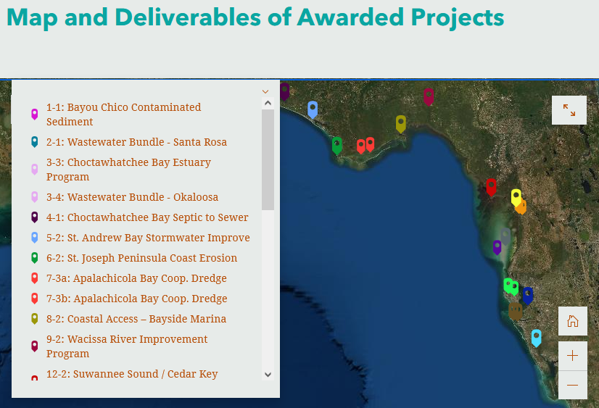
Gulf Consortium Project Data and Deliverables
Gulf Consortium StoryMap

Slide 28
Questions…
Contact:
Daniel Dourte
407.629.2185 ext. 113
ddourte@balmoralgroup.us

Slide 29
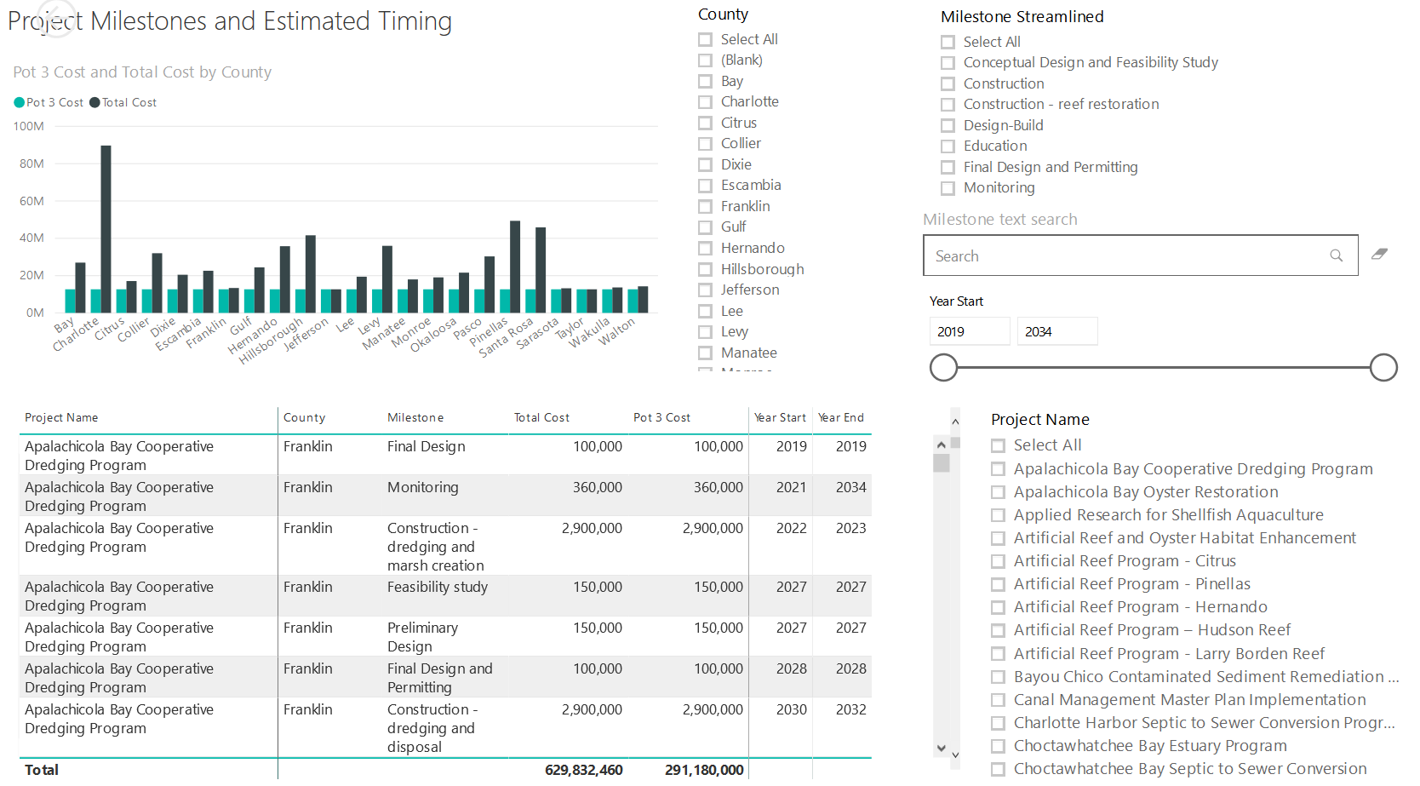
Application Preparation – Implementation Milestones and timing
Dashboard for Project Data
http://datavisual.balmoralgroup.us/GulfConsortiumProjects
milestones, start years, cost, goals, funding sources
GOAL:
Efficient, accurate grant application preparation
Interface for project details
Better, faster decisions on grant timing, readiness, bundling
Transparent tracking of progress and changes

