Slide 1
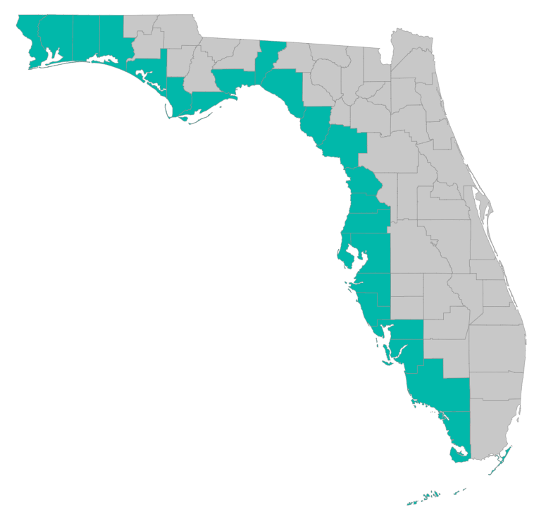
Grant Application Preparation and Submission
Coordinators Meeting

Slide 2
Overview
Which projects should get started
Timing/schedule of subaward applications
Information needed for complete applications
How to submit an application
Post-award tracking within programmatic grants

Slide 3
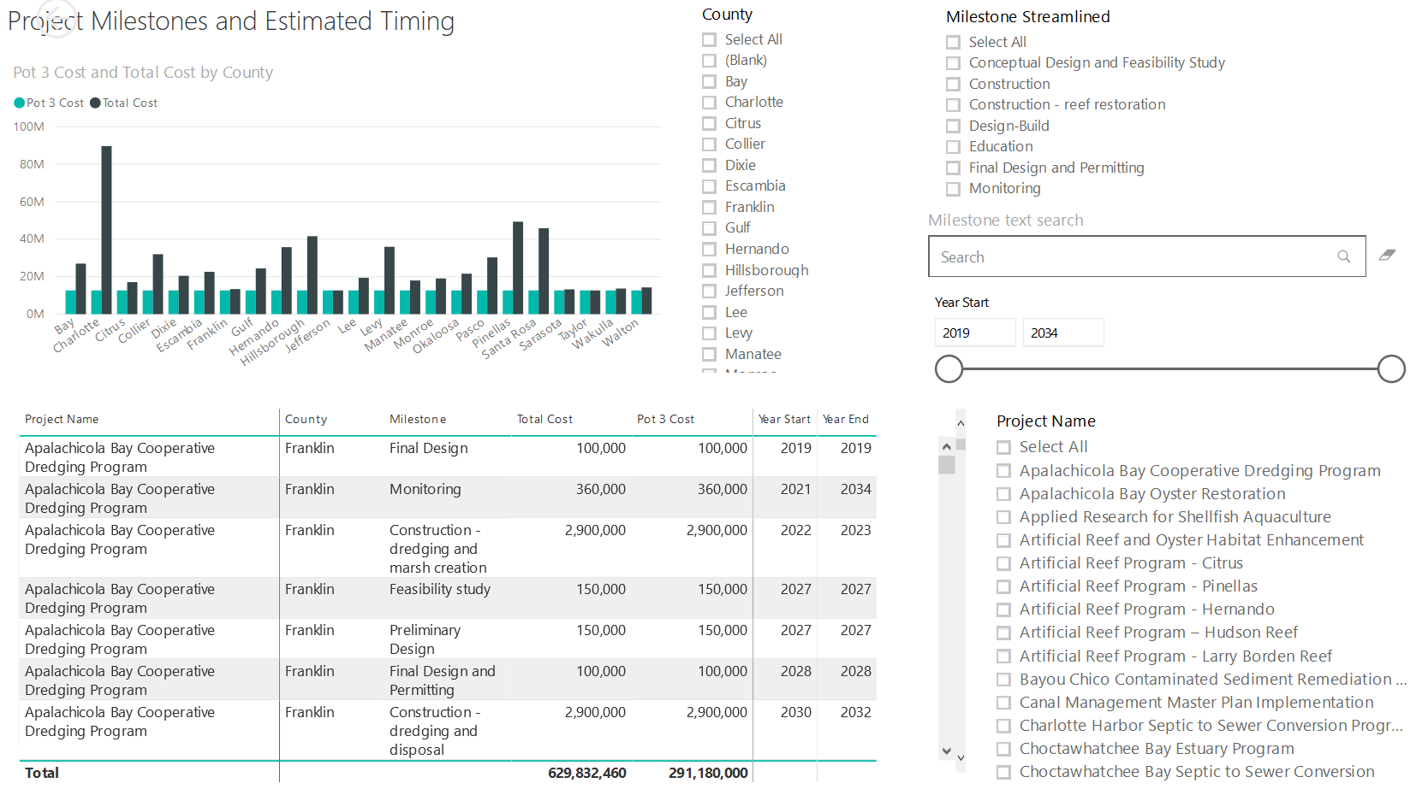
Application Preparation – Implementation Milestones and timing
Dashboard for Project Data
http://datavisual.balmoralgroup.us/GulfConsortiumProjects
milestones, start years, cost, goals, funding sources
GOAL:
Efficient, accurate grant application preparation
Interface for project details
Better, faster decisions on grant timing, readiness, bundling
Transparent tracking of progress and changes

Slide 4
Application Preparation – Implementation Milestones and timing
Grouped/bundled by like milestone types
Why these groups?
Streamline initial grant applications going to RESTORE Council in order to expedite their review – to get things going
Grouping by similar milestones allows for bundling of projects with similar documentation requirements
Milestone type | Number of milestones | Pot 3 cost
Conceptual Design and Feasibility Study | 57 | $ 8,449,463
Property feasibility studies and/or appraisal | 6 | $ 590,000
Final Design and Permitting | 30 | $ 14,411,132
Monitoring | 19 | $ 4,603,150
Education | 3 | $ 485,000
Construction | 13 | $ 24,600,131
Construction - reef restoration | 4 | $ 1,370,000
Sewer Access Fees | 3 | $ 1,424,500
Property acquisition | 8 | $ 23,850,000
Totals | 143 | $ 79,783,376
Colors indicate additional level of aggregation to streamline grants to Council:
Early design, feasibility, appraisal
Final design
Monitoring and miscellaneous
Construction and acquisition

Slide 5
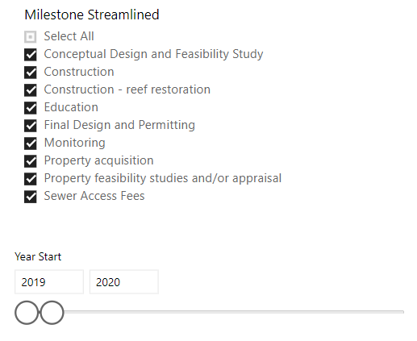
Application Preparation – Implementation Milestones and timing
http://datavisual.balmoralgroup.us/GulfConsortiumProjects

Slide 6
Application Preparation – Implementation Milestones and timing
Result
An upper limit on project milestones for which grant application development can begin
with expected milestone costs below the current Pot 3 FL trust fund amount: $73,917,036
if ALL grants for ALL milestones identified with 2019-2020 start date were delivered to RESTORE Council in early 2019 – there is some risk grant amounts ($79,783,376 total) would exceed available trust fund total
See http://datavisual.balmoralgroup.us/GulfConsortiumProjects
to review implementation milestones identified for potential grant application preparation

Slide 7
Application Preparation – Implementation Milestones and timing
Gulf Consortium: application review/assessment, BAS where needed, aggregation of grant applications by like milestones to expedite Council review
Subrecipients: subaward application preparation for project milestones

Slide 8
Application Preparation – Implementation Milestones and timing
Proposed rolling deadlines for subaward applications to be delivered to Consortium:
WHY?
To allow sufficient time for transfer of funds from Trust Fund to Council
To reduce the number of grants received by RESTORE Council, in order to expedite Council responses to grant packages
To allow for predictable planning of work effort and approvals
To allow Gulf Consortium grants to proceed and not be delayed by subrecipient grants that are not ready
Applications from subrecipients: deadline #1
1/31/2019
Applications from subrecipients: deadline #2
2/14/2019
Applications from subrecipients: deadline #3
4/26/2019
Applications from subrecipients: deadline #4
8/16/2019
Applications from subrecipients: deadline #5
10/4/2019

Slide 9
Application Preparation – Implementation Milestones and timing
Gulf Consortium Board approval of grant applications
To ensure all counties are in agreement on the projects moving forward to implementation
SEP Project Data (to determine the pool of project milestones to proceed with)
http://datavisual.balmoralgroup.us/GulfConsortiumProjects
Board Review and Action
(at each Board meeting)
Grant applications bundled to Council
Subaward applications from subrecipients

Slide 10
Application Preparation – Implementation Milestones and timing
Proposed Bundling for Grant Delivery to RESTORE Council
Dates of Board meetings at which work is approved to proceed for grant preparation to Council
1st bundle: Conceptual Design, Feasibility, Appraisal
1st bundle: Construction & Acquisition
TBD – predicated on Council approval
1st bundle: Final Design
1st bundle: Monitoring & Misc
First SEP Amendment
3/28/2019
2nd bundle: Conceptual Design, Feasibility, Appraisal
6/13/2019
Next group Grants from subrecipients: TBD
11/20/2019
2nd bundle: Construction, Acquisition 9/25/2019

Slide 11
Application Preparation – who does what
General Manager
Receives approval for application development
Requests applications; provides application instructions
Reviews for completeness; contracts for BAS if needed; combines like applications where appropriate
Deliver aggregated grant applications through RESTORE Councils grant management system
Coordinate with RESTORE Council on notifications, clarifications; notice of award
County point-of-contact for Pot 3 project implementation
Prepares application(s); submits to Gulf Consortium management
Provide additional information as needed
Provide additional information if needed; notice of subaward

Slide 12
Application Preparation – guidance
What is needed to submit a subaward application?
See guidance document at
https://www.gulfconsortium.org/grant-resources
Executive Summary
Project Narrative (BAS)
Budget Narrative
Milestone information
Metrics information (BAS)
Project Map
GIS shapefiles
Data Management Plan (BAS)
Observational Data Plan (BAS)

Slide 13
Application Preparation – guidance
How to submit a subaward application?
Online submittal form with attachments:
https://www.gulfconsortium.org/grant-resources
Attach all required documents as Word documents or pdf map and zipped shapefiles (for project location)

Slide 14
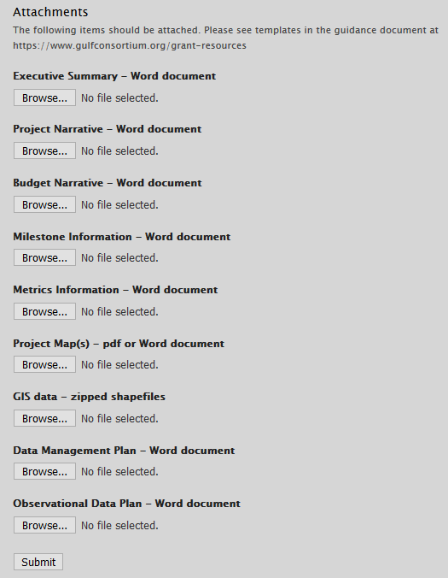
Application Preparation – guidance
How to submit a subaward application?

Slide 15
Hypothetical Example Grant Project Accounting
Post-award issues for programmatic grants
Concept Design & Feasibility Study Grant
No. 100100
Project Accounting tracks funds and payments separately as tasks under the Master Grant project number.
County No. 017 can complete their portion of the subaward prior to or after County No. 005, 015 or 029 (or any other combination).
If County No. 017 completes their Concept Design subaward and is ready for their next subaward, closeout procedures for their portion of the subaward would be completed and filed and their next subaward – for Final Design or for a new Concept Design if the first proved infeasible – would be prepared. The remaining counties are not impacted.
County
No. 005
County
No. 015
County
No. 017
County
No. 029
Subaward 1001005
$440,000
Subaward 1001017
$100,000
Subaward 1001029
$350,000
Subaward 1001015
$650,000

Slide 16
Application Preparation – Implementation Milestones and timing
Gulf Consortium OSA and subrecipient OSAs and audits
Consortium Review of County processes for Council Compliance
Address Findings
Modify Terms & Conditions
Update Annually
OSA and Audit Review

Slide 17
Application Preparation – guidance
Questions…
Contact:
Daniel Dourte
407.629.2185 ext. 113
ddourte@balmoralgroup.us

