Slide 1
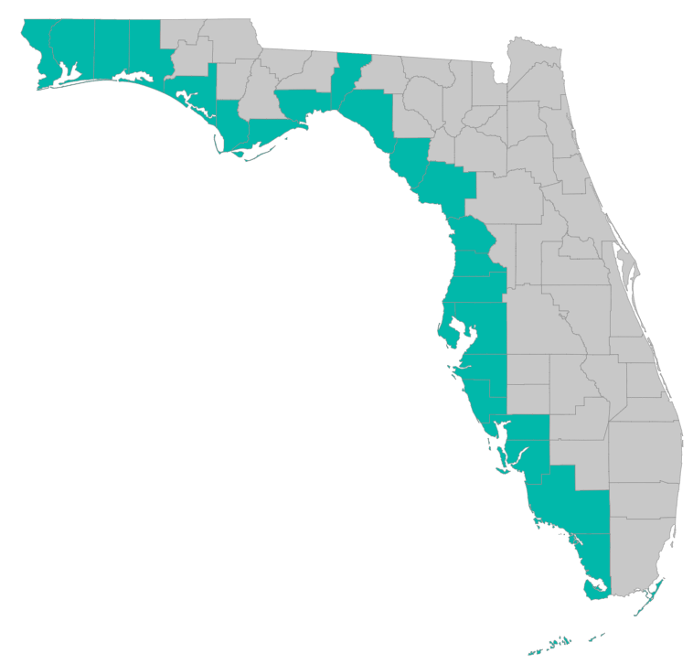
SEP Project Implementation – updates and Q&A
February 27, 2019 – GoToMeeting
Please join my meeting from your computer, tablet or smartphone. https://global.gotomeeting.com/join/785710869 You can also dial in using your phone. United States: +1 (312) 757-3119 Access Code: 785-710-869

Slide 2
SEP Project Implementation info session agenda
Checklists, templates, guidance
https://www.gulfconsortium.org/grant-resources
Environmental Compliance checklist – a really long one
Feedback from Council
Separating Council-funded portions of larger projects
Describing procurements – especially for continuing services
Dates: period of performance
Metrics – must have at least one for every application
Q&A

Slide 3
Application Preparation – guidance
What is needed to submit a subaward application?
See guidance documents and templates at
https://www.gulfconsortium.org/grant-resources
Project Abstract
Project Narrative (BAS)
Budget Narrative
Budget Table (SF 424 object class categories)
Milestone information
Metrics information (BAS)
Environmental Compliance Checklist (NEW)
Project Map
GIS shapefiles
Data Management Plan (BAS)
Observational Data Plan (BAS)
Cash Drawdown Projection and Leveraged Funding form

Slide 4
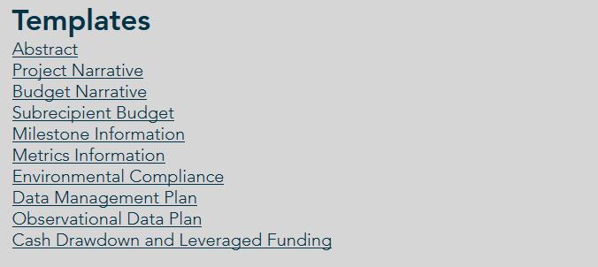
Application Preparation – guidance
What is needed to submit a subaward application?
https://www.gulfconsortium.org/grant-resources
Please use templates

Slide 5
Application Preparation – guidance
Environmental Compliance
Environmental Requirement | Has the requirement been addressed? | Compliance Notes (e.g., status of application, permit number, etc.)
National Environmental Policy Act | ___ Yes ___ No ___ N/A
Endangered Species Act | ___ Yes ___ No ___ N/A
National Historic Preservation Act | ___ Yes ___ No ___ N/A
Magnuson-Stevens Act (Essential Fish Habitat) | ___ Yes ___ No ___ N/A
Fish and Wildlife Coordination Act | ___ Yes ___ No ___ N/A
Coastal Zone Management Act | ___ Yes ___ No ___ N/A
Coastal Barrier Resources Act | ___ Yes ___ No ___ N/A
Farmland Protection Policy Act | ___ Yes ___ No ___ N/A
Clean Water Act Section 404 | ___ Yes ___ No ___ N/A
Clean Water Act Section 401 | ___ Yes ___ No ___ N/A
River and Harbors Act Section 10 | ___ Yes ___ No ___ N/A
Marine Protection, Research and Sanctuaries Act | ___ Yes ___ No ___ N/A
Marine Mammal Protection Act | ___ Yes ___ No ___ N/A
National Marine Sanctuaries Act | ___ Yes ___ No ___ N/A
Migratory Bird Treaty Act | ___ Yes ___ No ___ N/A
Bald and Golden Eagle Protection Act | ___ Yes ___ No ___ N/A
Clean Air Act | ___ Yes ___ No ___ N/A

Slide 6
Application Preparation – guidance
Environmental Compliance
“For activities that involve only planning (with no implementation funding), the sponsor should normally check “N/A” for the laws listed below. However, there may be instances where a component of a planning activity may trigger one or more laws, for example engineering and design including geotechnical sampling requiring a CWA Section 404 permit.”
Interagency group being established to ensure Environmental Compliance is handled efficiently

Slide 7
Separation of effort, milestones, funds
Council needs to see what exactly the Pot 3 funds will accomplish
“we can’t pay for half a bridge”
Need narrative to provide some separation (geographic or % complete or other) between what leverage funds achieve and what Pot 3 funds achieve

Slide 8
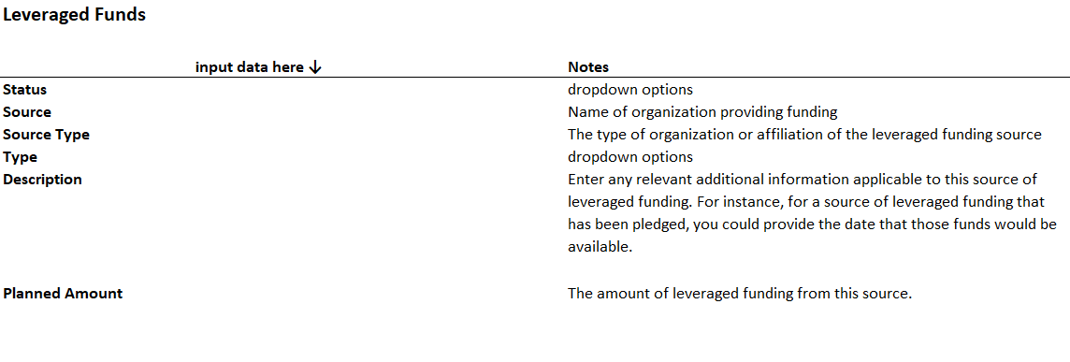
Application Preparation – guidance
Leveraged funding source information
See template (NEW) https://www.gulfconsortium.org/grant-resources
“Cash drawdown and Leveraged Funding”

Slide 9
Application Preparation – guidance
Leveraged funding type – 3 choices:
Most complicated (multiple agencies reviewing application)
Co-Funding: Costs will be shared across funding from two or more sources. The leveraged funding from all sources is required in order to achieve the project or program objectives.
Simpler
Adjoining: Activities are proposed in a location that adjoins another existing or proposed project. Geographic proximity is key to this type of leveraging.
Builds on Other Work: The project builds upon activities completed as part of other projects or programs but is not captured by either of the other two types of leveraging.

Slide 10
Observational Data Plan
Every application needs a metric
https://www.gulfconsortium.org/grant-resources

Slide 11
Observational Data Plan
Sample planning project metric and supporting data:
Metric: PRM001 - # studies/models used to inform management
Metric PRM001 Success Criteria: 2 reports compiled in support of technical design, environmental compliance, and monitoring
Parameter I: Data Collection Report
Success Criteria Parameter I: Completion of a data collection report to support preliminary and final project design. The final data collection report may include, but is not limited to, the following sub-reports: bathymetric, topographic, and magnetometer survey reports, and geotechnical reports.
Parameter II: Preliminary Design Report
Success Criteria Parameter I: Completion of a preliminary design report and draft 30% set of project plans to support permit application and present recommended project features, surveys, location of borings, cost estimates, and draft adaptive management and monitoring plan.

Slide 12
Observational Data Plan
What if we don’t meet the numeric success criteria we used for a metric?
Just explain why
Opportunity for adaptive management
No financial consequences (assuming work was actually implemented)
Metric choice
Start with “Metrics suggestions and new metrics” spreadsheet at https://www.gulfconsortium.org/grant-resources

Slide 13
Period of Performance
The time between “Project Start Date” and “Project End Date”
… from Council guidance
Project Start Date: The anticipated start date of proposed activities. This is the date the applicant wants the award term to start.
Project End Date: The anticipated end date of proposed activities. This is the date that the applicant wants the award term to end.
Hint: When entering the Start and End dates, try to set dates that are realistic. Remember to provide sufficient time for the Council staff to review the application and process the award, for any applicable contracts to be negotiated, and for the entire project or program scope of work, including any close out activities, to be completed.

Slide 14
Period of Performance
What to do if you want to start work (with allowable costs) right away (before Council says yes to an award):
… from Council guidance
If there is additional funding:
Separate the Pot 3 funded portion into a distinct deliverable that follows deliverables completed with other funds (E&D – 50% complete plans; or dredging 500,000 cu. yd. in NW portion of lake)
Prepare a pre-award letter (how much $, when it starts, reason it starts right away, what the $ is for)
If there is NOT additional funding:
Wait until award
Prepare a pre-award letter – with help of Consortium staff

Slide 15
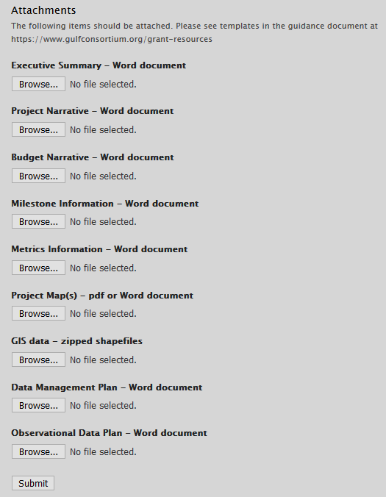
Application Preparation – guidance
How to submit a subaward application?

Slide 16
Application Preparation – guidance
Applications being prepared for Council (as of 2/27/2019):
County | Project | Amount
Citrus | 13-1: NW Quadrant Sewer Force Main Project (Final design and permitting) | $ 285,000
Wakulla | 8.2: Coastal Public Access Program - Bayside Marina Feasibility Study | $ 25,750
Pinellas | 16-1: Lake Seminole Sediment Removal (Dredging) | $ 1,600,000
Charlotte | 20-1: Charlotte Harbor Septic to Sewer Conversion Program (Project Design) | $ 1,833,993
Okaloosa | 3-4: Shoal River Headwaters Protection Program (HPP) - Phase I (BSAIP WRF Effluent Disposal Expansion) (Final design and permitting) | $ 100,000
Okaloosa | 3-3: Chocktawhatchee Bay Estuary Program | $ 1,000,000
Pasco | 15-5: Artificial Reef Program - Hudson Reef (material delivery and deposition) | $ 100,000
Santa Rosa | 2-1: Soundside Drive Septic to Sewer Conversion, Phase I (Final design and permitting) | $ 415,000

Slide 17
Application Preparation – guidance
Next suggested date to submit applications by: 4/26/2019
Don’t need to wait until then – submit whenever you’re ready
What portions of projects can proceed? Anything with a 2019 or 2020 start date in the SEP… see http://datavisual.balmoralgroup.us/GulfConsortiumProjects and ask us for help or suggestions

Slide 18
Application Preparation – guidance
Questions…
Contact:
Daniel Dourte
407.629.2185 ext. 113
ddourte@balmoralgroup.us

Slide 19
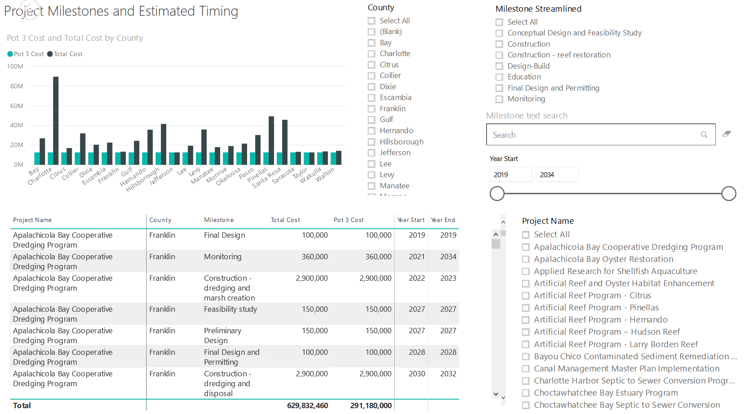
Application Preparation – Implementation Milestones and timing
Dashboard for Project Data
http://datavisual.balmoralgroup.us/GulfConsortiumProjects
milestones, start years, cost, goals, funding sources
GOAL:
Efficient, accurate grant application preparation
Interface for project details
Better, faster decisions on grant timing, readiness, bundling
Transparent tracking of progress and changes

