Slide 1
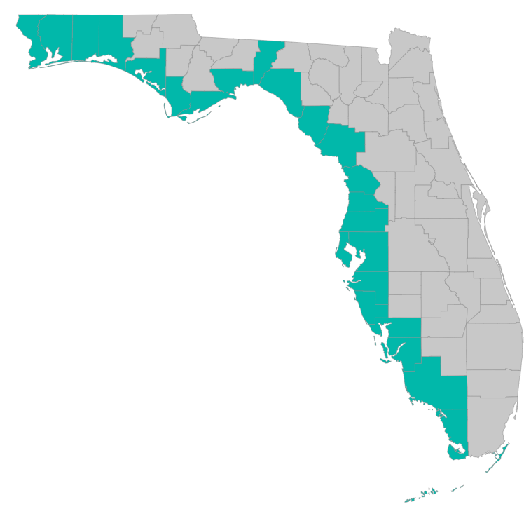
SEP Project Implementation – updates and Q&A
June 13, 2019 – GoToMeeting
Please join my meeting from your computer, tablet or smartphone. https://global.gotomeeting.com/join/785710869 You can also dial in using your phone. United States: +1 (312) 757-3119 Access Code: 785-710-869

Slide 2
SEP Project Implementation info session agenda
Checklists, templates, guidance
https://www.gulfconsortium.org/grant-resources
Budget and Budget Narrative
Subrecipient Agreements
Subrecipient Reporting and Payment Requests
What applications should proceed?
Q&A

Slide 3
Application Preparation – guidance
What is needed to submit a subaward application?
See guidance documents and templates at
https://www.gulfconsortium.org/grant-resources
Project Abstract
Project Narrative (BAS)
Budget Narrative
Budget Table (SF 424 object class categories)
Milestone information
Metrics information (BAS)
Environmental Compliance Checklist
Project Map
GIS shapefiles
Data Management Plan (BAS)
Observational Data Plan (BAS)
Cash Drawdown Projection and Leveraged Funding form

Slide 4
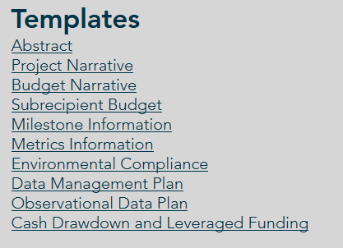
Application Preparation – guidance
What is needed to submit a subaward application?
https://www.gulfconsortium.org/grant-resources
Please use templates: more complete applications = less management cost
Save each of the blank templates; then save as project-specific name and fill them in

Slide 5
Application Preparation – guidance
See example application materials
https://www.gulfconsortium.org/grant-resources
Please use templates: more complete applications = less management cost

Slide 6
Budget Narrative
Every $ needs a reason
Meaning: we need to know the source of the cost estimates (from quotes, based on similar work in past, using accepted unit cost, etc.)
This is 100% for sure going to require edits during RESTORE Council review… if there’s a cost estimate without the narrative to determine where it comes from we’ll need to change
Reasonable, allowable, allocable – Council needs to determine those 3 things for all costs

Slide 7
Budget Narrative
Council needs to see what exactly the Pot 3 funds will accomplish
“we can’t pay for half a bridge”
Need narrative to provide some separation (geographic or % complete or other) between what leverage funds achieve and what Pot 3 funds achieve
If we can’t separate, we have to call it “co-funded” and then we have to track and report on all the funding sources (more admin $)

Slide 8
Budgets
Leaving room for management and legal costs:
Requesting subrecipient costs for the full amount of SEP project milestone amounts could result in over-allocation of funds
Example: $1M project in SEP; if the subrecipient portion is $1M, the total Gulf Consortium cost might be $1,060,000 (to account for mgmt. and legal effort). If this happens for all projects (AND we spend all the budgeted amounts) we run the risk of not having enough money for projects in the future.
Solutions:
We spend less than we budget
We account for management/legal effort required of projects

Slide 9
Procurements
If you already hired someone to do the work:
Explain the procurement (in Budget Narrative)
Send procurement backup to Gulf Consortium (ddourte@balmoralgroup.us):
RFP
Winning response
Resulting contract
If you will do a new procurement:
Explain the procurement (in Budget Narrative)
Describe compliance with county policies and federal rules

Slide 10
Subrecipient agreements
Some comments so far…
Reporting (Section 7)
Within 20 days of twice-annual reporting deadline (Mar 31 and Sep 30 OR Jun 30 and Dec 31); Consortium has 30 days (allows for 10 days for Consortium)
Within 45 days of end of project; Consortium has 90 days (allows for 45 days for Consortium)
Payment requests (Section 4 and Section 5);
will likely shorten the Consortium’s review times to ensure payments can be made within 45 days
30 days for final payment request (after end of agreement); Consortium has 90 days
Other comments for Legal to address…

Slide 11
Post-award reporting
Twice each year (financial and performance reports)
See example forms at https://www.gulfconsortium.org/grant-resources bottom of page “Example Semi-Annual Report and Payment Request”
Combined financial and performance report form
Form SF-PPR “Performance Progress Report” is basis of performance report form
Form SF-425 “Federal Financial Report” is basis of financial report form
Payment request form

Slide 12
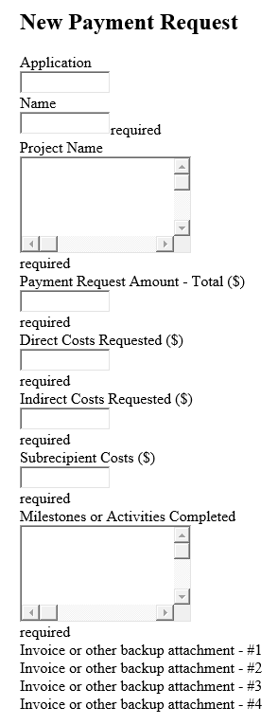
Post-award reporting
Payment requests

Slide 13
Application Preparation – upcoming applications
Next suggested date to submit applications by: 8/16/2019
Don’t need to wait until then – submit whenever you’re ready
What portions of projects can proceed? Anything with a 2019 or 2020 start date in the SEP… see http://datavisual.balmoralgroup.us/GulfConsortiumProjects and ask us for help or suggestions

Slide 14
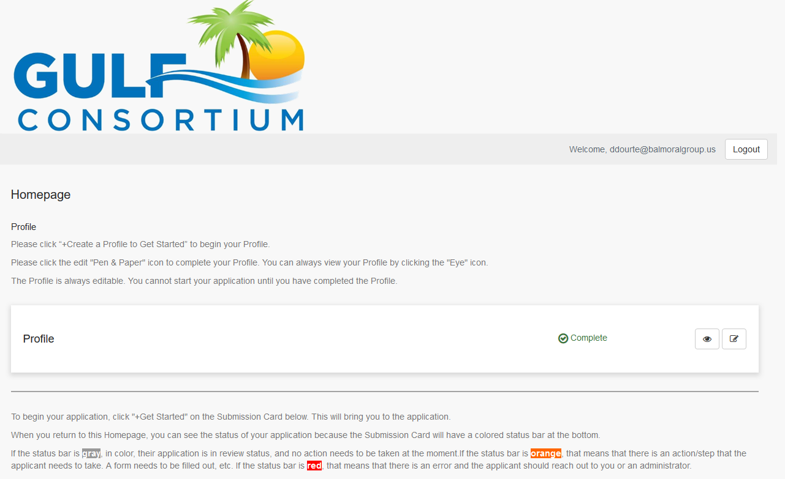
Application Preparation – upcoming applications
How to submit a subaward application? NEW grants mgmt. system
https://webportalapp.com/sp/gulfconsortium_sep_projects

Slide 15
Application Preparation – upcoming applications
Start with templates
https://www.gulfconsortium.org/grant-resources
See example materials
https://drive.google.com/drive/folders/1aELD3bw5M0TqJ2QoghS8EfyguhyqxECb

Slide 16
Application Preparation – upcoming applications
How to submit a subaward application? NEW grants mgmt. system
Make a profile
Add an application
Fill out and submit an application
Use templates locally or on your servers to make complete application attachments before submittal (budget, budget narrative, etc.)
https://webportalapp.com/sp/gulfconsortium_sep_projects

Slide 17
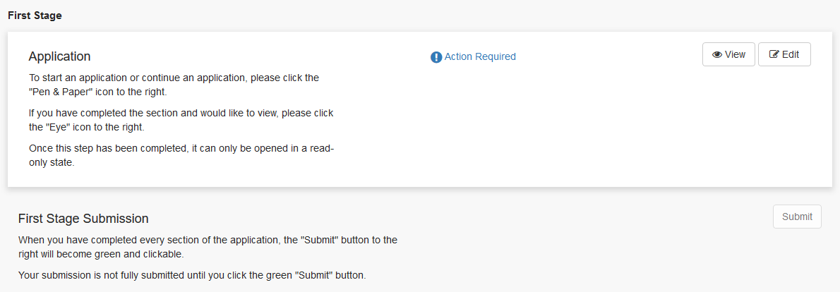
Application Preparation – upcoming applications
How to submit a subaward application? NEW grants mgmt. system
https://webportalapp.com/sp/gulfconsortium_sep_projects

Slide 18
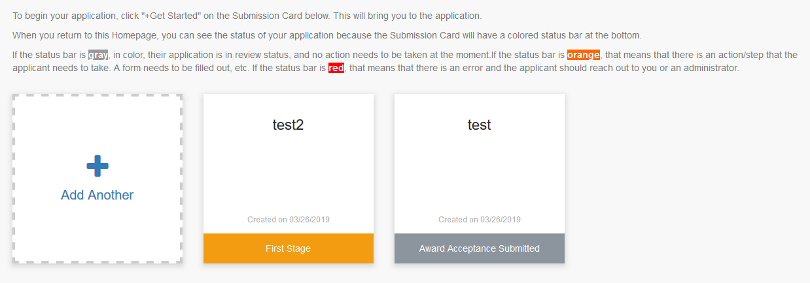
Application Preparation – upcoming applications
How to submit a subaward application? NEW grants mgmt. system
https://webportalapp.com/sp/gulfconsortium_sep_projects
On homepage, can always see status of all applications associated with your profile

Slide 19
Direct Component OSA’s
Prepared for Treasury (due June 30?)
Please send us a copy

Slide 20
Treasury final rule on administrative cost limits
DEPARTMENT OF THE TREASURY
31 CFR Part 34
RIN 1505–AC55
Gulf Coast Restoration Trust Fund
AGENCY: Office of the Fiscal Assistant
Secretary, Treasury.
ACTION: Final rule
Effective May 3, 2019
Short version: the 3% limit on non-facilities “indirect costs for administration” can be applied at an aggregate basis if desired (not just grant-by-grant)
Long version: Federal Register / Vol. 84, No. 64 / Wednesday, April 3, 2019

Slide 21
Real Estate and Property Acquisition
Anyone have a “Policy on Real Property Acquisition & Relocation”… Item 26 on the Pot 1 OSA?
Appraisal cost estimates ???

Slide 22
Questions…
Contact:
Daniel Dourte
407.629.2185 ext. 113
ddourte@balmoralgroup.us

Slide 23
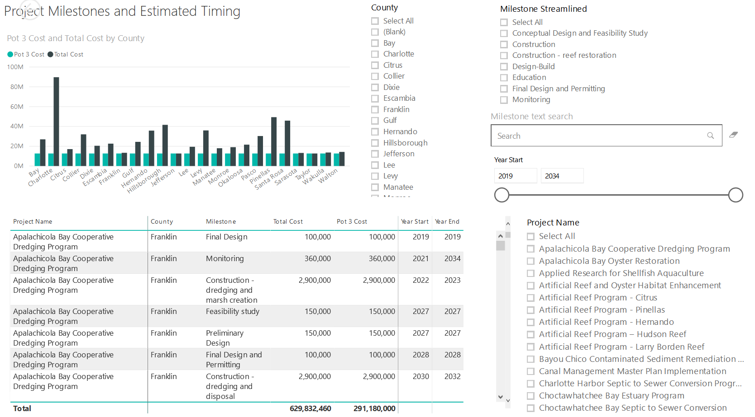
Application Preparation – Implementation Milestones and timing
Dashboard for Project Data
http://datavisual.balmoralgroup.us/GulfConsortiumProjects
milestones, start years, cost, goals, funding sources
GOAL:
Efficient, accurate grant application preparation
Interface for project details
Better, faster decisions on grant timing, readiness, bundling
Transparent tracking of progress and changes

