Slide 1
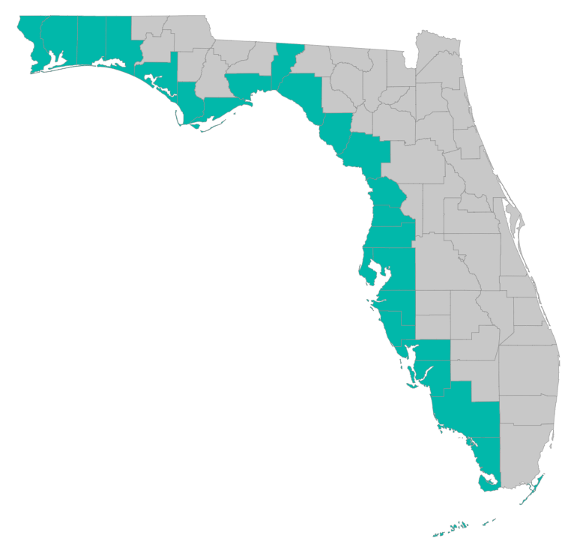
SEP Project Implementation – updates and Q&A
July 8, 2021 – GoToMeeting
Please join my meeting from your computer, tablet or smartphone. https://global.gotomeeting.com/join/785710869 You can also dial in using your phone. United States: +1 (312) 757-3119 Access Code: 785-710-869

Slide 2
RESTORE Coordination Meeting – 7/8/2021
Objective: Improve efficiency in project implementation by sharing lessons learned
Identify challenges and solutions in project implementation
Draft Agenda
10 AM: Welcome and Round Robin
Recommendation on what to highlight – focus on what the group could learn from:
Things learned (techniques, procedures, docs, etc) that could benefit other counties
Problems county RESTORE programs are running into that others might have faced, might face in the future
New types of projects that may benefit from different approaches in the RESTORE process
What are you dealing with now that you have questions about or could use help with?
County list: Escambia, Santa Rosa, Okaloosa, Walton, Bay, Gulf, Franklin, Wakulla, Jefferson, Taylor, Dixie, Levy, Citrus, Hernando, Pasco, Hillsborough, Pinellas, Manatee, Sarasota, Charlotte, Collier, Lee, Monroe
10:45 AM: RESTORE Council, Treasury, and FDEP updates as needed
11:00 AM: NRDA Updates (Gareth Leonard)
11:15 AM: SEP project implementation discussion
Grant application reminders, examples; templates
Timeline for grant applications – start now for work you want to start in a year
Post-award reporting, closeouts, extensions, deliverables, and payment requests
11:30 AM: recommendations for next meeting – what to focus on, topic of interest?

Slide 3
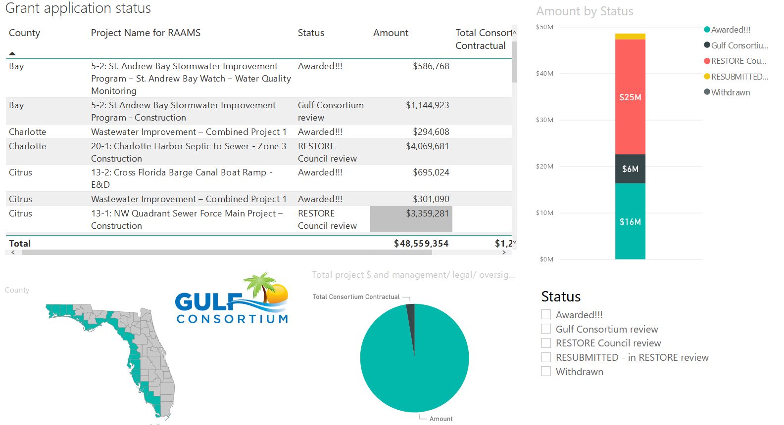
Application Status
Where’s my application, when will an award be made?
http://datavisual.balmoralgroup.us/GulfConsortiumProjects
(p. 8, navigation arrows at bottom)

Slide 4
Application Timeline
Plan for at least 9 months from the time you submit to Gulf Consortium to the time RESTORE Council makes an award
9 months
Application submission to Consortium
Award from RESTORE Council

Slide 5
Application Preparation – guidance
What is needed to submit a subaward application?
See guidance documents and templates at
https://www.gulfconsortium.org/grant-resources
Project Abstract
Project Narrative (BAS)
Project Map (can be picture of pdf or word doc)
Milestone information (spreadsheet; include deliverables)
Budget Narrative
Budget Table (spreadsheet; SF 424 object class categories)
Leveraged Funding form (don’t need drawdown schedule)
Metrics information (BAS)
Observational Data Plan (BAS)
Data Management Plan (BAS)
Environmental Compliance Checklist
GIS shapefiles – or map/picture (don’t let this hold you up – we can quickly make these)
Recommended order

Slide 6
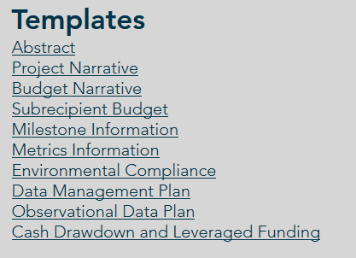
Application Preparation – guidance
What is needed to submit a subaward application?
https://www.gulfconsortium.org/grant-resources
Please use templates: more complete applications = less management cost
Save each of the blank templates; then save as project-specific name and fill them in

Slide 7
Application Preparation – upcoming applications
Next suggested date to submit applications by: 8/6/2021
Don’t need to wait until then – submit whenever you’re ready
What portions of projects can proceed? Anything with a 2019 to 2023 (or maybe even after that) start date in the SEP… see http://datavisual.balmoralgroup.us/GulfConsortiumProjects and ask us for help or suggestions

Slide 8
Application Preparation – upcoming applications
IMPORTANT for reducing overhead:
Don’t separate projects into smaller pieces than necessary… every grant/project needs an application and twice-annual performance and financial reports
Look at the most complete tangible deliverable(s) you can complete with the information you have and submit for that milestone(s)

Slide 9
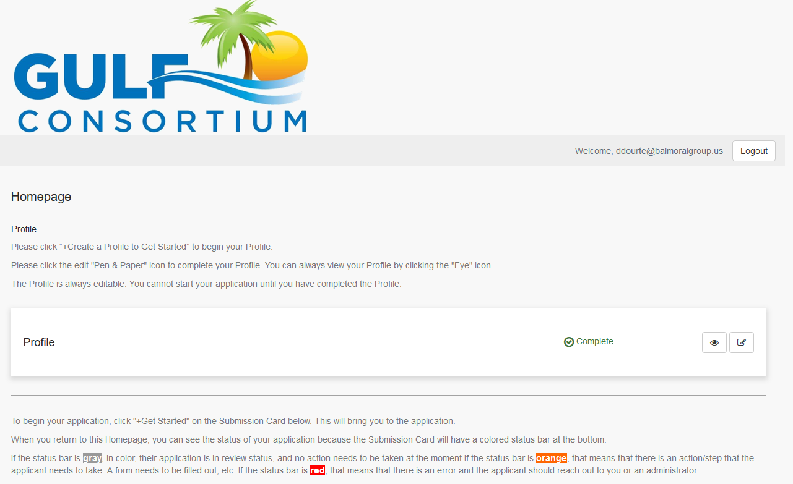
Application Preparation – upcoming applications
How to submit a subaward application? Online at:
https://webportalapp.com/sp/gulfconsortium_sep_projects

Slide 10
Application Preparation – upcoming applications
How to submit a subaward application? Grants mgmt. system
Make a profile
Add an application
Fill out and submit an application
Use templates locally or on your servers to make complete application attachments before submittal (budget, budget narrative, etc.)
https://webportalapp.com/sp/gulfconsortium_sep_projects

Slide 11
Procurement FAQs
See procurement FAQs doc at https://www.gulfconsortium.org/grant-resources
Follow county policies
Be sure procurement is federally compliant (2 CFR 200)
11

Slide 12
Procurement Review
Let Gulf Consortium know about procurement plans
Existing (CCNA) procurements may be allowed, but these need case by case review – see memo from Legal Counsel (NGN)
See “Procurement Information” section at https://www.gulfconsortium.org/grant-resources
Compliance with: 2 CFR § 200.317 - 326

Slide 13
Procurement Review
If you already hired someone to do the work:
Explain the procurement (in Budget Narrative) and past involvement of selected firm (if applicable) and explain 2 CFR 200 compliance
Send procurement backup to Gulf Consortium (ddourte@balmoralgroup.us):
RFP/RFQ
Ranking sheet
Resulting contract
If you will do a new procurement:
Explain the procurement (in Budget Narrative)
Describe compliance with county policies and federal rules
Send the procurement docs (above) to Consortium management and legal
13

Slide 14
Cost Escalation
How to get costs right at grant application stage...
Don’t rely on SEP estimated $
Do internal cost analysis
If you have an engineer’s estimate of construction costs – can(should) it be updated?
Other ideas?
Goal: minimize amendments to awards and to the SEP
14

Slide 15
Post-award Reporting and Invoicing
Important Links:
Performance Report - https://webportalapp.com/webform/performancereport
Financial Report - https://webportalapp.com/webform/financialreport
Invoicing - https://webportalapp.com/webform/paymentrequest
Deliverables - https://webportalapp.com/webform/deliverables ; plans, permits, reports, data

Slide 16
Post-award Reporting and Invoicing
Performance Report template at https://www.gulfconsortium.org/grant-resources
Let us know right away if you’re behind schedule or if there’s a major change in your project
Update your ODP
Timeline
Financial Report template provided to subrecipients by email for 1st report, then it is updated for future reports

Slide 17
Closeout Reporting
Important Links:
Final Performance Report with ODP closeout template soon at https://www.gulfconsortium.org/grant-resources

Slide 18
Questions…
Contact:
Daniel Dourte
407.629.2185 ext. 113
ddourte@balmoralgroup.us

Slide 19
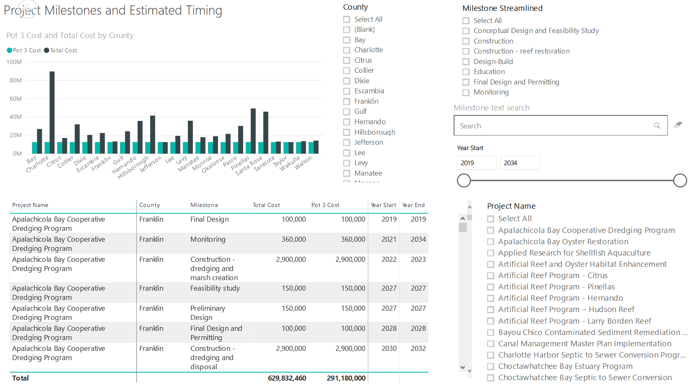
Application Preparation – Implementation Milestones and timing
Dashboard for Project Data
http://datavisual.balmoralgroup.us/GulfConsortiumProjects
milestones, start years, cost, goals, funding sources
GOAL:
Efficient, accurate grant application preparation
Interface for project details
Better, faster decisions on grant timing, readiness, bundling
Transparent tracking of progress and changes

